Slide 1
Push-in Contextualized ELD
Session 3. Friday, Oct 10, 2014 7:30-11:15
Presentation Schedule
Research on Push-in Models: Benefits and Challenges
Four Language Skills and Classroom Assessment
Break
Presentations

Slide 2
Presentation Schedule
1st grade: Kara, Teal , Erica, Casey and Beth/Tracy
2nd grade: Vanessa, Rebecca and Beth/Tracy
3rd grade: Bobbie, Brittany, Kristy, Larrisa and Beth/Tracy

Slide 3
Reflection and Discussion:
How is the Push-in ELD Model working?

Slide 4
What the research says…
In a recent study, a school district in Wisconsin adopted a fully collaborative co-teaching model for the instruction of English learners that resulted in increases in English proficiency levels of 28 percent in just 3 years (Honigsfeld & Dove, 2012).

Slide 5
Benefits
ELLs
Academic and social benefits:
Remain in the classroom with peers
Are exposed to mainstream content in the context of ELD
Receive an expanded and enriched curriculum tailored to their needs
Teachers
More willing to try new and creative ideas
Empowerment as a result of shared decision-making
Co-planning helped teachers create new connections across the curriculum
(Martin-Beltran & Peercy, 2012)

Slide 6
Challenges
ESL teachers cite some concerns...
They do not want to lose ownership of their students
Should not be relegated to the status of an aide.
Collaboration can be a lot of additional work if they are co-teaching with several different teachers.
(Haynes, 2007)

Slide 7
Creating culture of collaboration…
Elements necessary for sustainment of collaboration:
feeling valued, a sense of belonging
contextual conditions such as administrative support and scheduled time for collaboration
equal status as collaborators, being willing to collaborate
sharing a sense of ownership of and responsibility for educating ELLs
(Bell & Baecher, 2012)

Slide 8
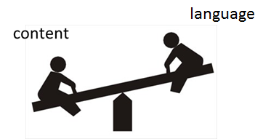
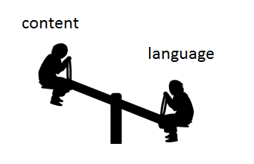
Models for ELD in the Content Classroom
ELD
Content
Teach new language
Recycle/review/practice familiar content
Use ELP standards to guide instruction
Forms and Functions
Differentiated instruction according to proficiency levels of ELL students
Teach new content
Recycle/review/practice familiar language
Use content standards to guide instruction
Literacy, Science, Social Studies, Math
“Sheltered strategies” used to make content accessible

Slide 10
Reflection and Discussion:
Assessment of Language Learners

Slide 11
An important principle to remember…
ELD instruction should provide extensive input, and it should also give students opportunities for output and interaction.

Slide 12
Oracy and Literacy
R | ORACY |  | P
E |  |  | R
C |  |  | O
E | Listening | Speaking | D
P |  |  | U
T |  |  | C
I | Reading | Writing | T
V |  |  | I
E |  |  | V
 | LITERACY |  | E

Slide 13
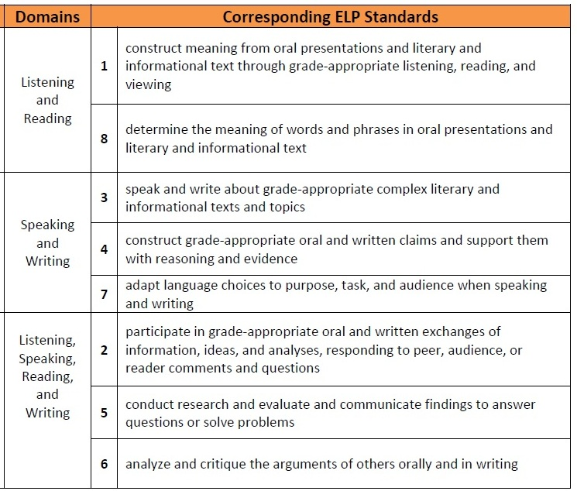
ELP Standards
Modalities
Receptive
Productive
Interactive

Slide 14
Listening
Listening to Repeat | Listening to Understand | Listening for Communication
Poems Songs Chants Dialogues | TPR Listen & answer comprehension questions Listen and take notes Dialogues Lectures TV shows/videos | Communicative games Information-gap activities Interviews Cooperative problem-solving

Slide 15
Speaking
Guided Practice | Communicative Practice | Free Conversation
Dialogues Mini-conversations Role plays Strip stories | Simulations Guessing games Brainstorming Interviews Surveys | Discussion groups Debates Panel discussions Storytelling

Slide 16
Reading
Pre-reading | During-reading | Post-reading
Build background knowledge Relate to students’ lives Pre-teach vocabulary and concepts Examine text organization Modify the text to make it accessible for ELLs (e.g., highlighting, drawing diagrams, adding notes in native language, making an audiotape) | Using Headings and Subheadings Vocabulary Strategies/Clustering Jigsaw Procedure Learning Logs Graphic Organizers Illustrating Stories and Poems/Story Mapping | Journals/learning logs Photo essays Written and oral collaborative research projects Developing Scripts for Readers’ Theater Adapting Stories into Plays and Film Scripts

Slide 17
Writing
 | MOST SUPPORT
Teacher writing | The teacher demonstrates the writing of a text, discussing his/her thinking as he/she writes
Shared writing | The teacher records a text that the children dictate; supports student generation of ideas by asking questions and reflecting on text content, development, organization, conventions, etc.
Choral writing | Teacher and children write a text together; teacher and individual students take turns generating and recording new ideas
Guided writing | Individual children write a text, with the teacher providing support as necessary
Paired writing | Two children write a text together
Independent writing | Each child writes a text independently
 | LEAST SUPPORT

Slide 18
Look at the lessons you have developed so far
Identify activities that encourage students to practice…
Listening
Speaking
Reading
Writing

Slide 19
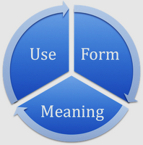
Authentic Formative Assessment
closely monitoring ELL’s language development
by observing their ability to listen, speak, read, and write
in order to be a part of the class and do their school work.
Authentic
assessment tasks are real, communicative uses of language

Slide 20
Some Ways to Assess ELLs in Oral Language, Reading, and Writing
Oral Language (List & Speak)
informal conferencing
observation during cooperative activities
interview—Q & A
picture-cued descriptions
story-telling/relating events
impromptu role plays
debates
various oral presentations
video production
What else?
Reading and Writing
graphic organizers to classify words or phrases
sequencing pictures, sentences, or paragraphs
drawing based on written text
matching words with pictures, words, phrases, sentences; matching sentences with paragraphs
underlining or highlighting main ideas or supporting details
cloze exercises, miscue analysis
discussion groups, comprehension ?s
essays (expository, persuasive)
narratives (real or fictional)
summaries
notes, journals, and logs
portfolio of writing samples
What else?

Slide 21
Look at the lessons you have developed so far…
Identify ways you can assess your ELLs in these areas:
Oral Language (Listening and Speaking)
Reading/Writing

Slide 22
Speaking and Writing Rubric

Slide 23
Effective Practices
Use daily teaching events
Match assessments to instructional practices
Use a variety of tools
Use assessment to plan instruction
Make assessments recursive
Interpret data
Set goals
Collect data

Slide 24
Presentations

