Slide 1



Push-in Contextualized ELD
Session 2. Friday, Sept. 26, 2014
Warming up with linguistics
Larsen-Freeman (2014)
Model Lesson
Break
Discussion of Fillmore & Fillmore Article and Text Complexity
Form & Meaning: Prepositional Phrases

Slide 2


ELL Language Production
Elements in the system of language
Phonology: the study of the sounds of a language
Morphology: the study of words and parts of words
Syntax: the study of the structure of sentences and the rules that govern their formation
Semantics: the study of meanings of individual words and of larger units such as phrases and sentences
Pragmatics: the study of language use in context

Slide 3
Larsen-Freeman (2014)
Re-read the “Experience” section at the beginning of the article.
What do you notice about this example?
Have you ever had a similar experience as a student?
How about as a teacher?

Slide 4
Jigsaw Activity with Larsen-Freeman (2014)

Slide 5
Section 1: How is Grammar Taught?
A Three-Dimensional Grammar Framework and the Learning Process
Explain the difference between “prescriptive grammar” and “descriptive grammar.”
How do these ideas relate to the opening example?
How do they relate to the three-dimensional framework?

Slide 6
Three-Dimensional Grammar Framework
MEANING/
SEMANTICS
USE/
PRAGMATICS
FORM/
STRUCTURE

Slide 7
Section 1: How is Grammar Taught?
A Three-Dimensional Grammar Framework and the Learning Process
Summarize the author’s four insights regarding the learning process
  Learners do not learn constructions one at a time.
  Even when learners appear to have mastered a particular construction, it is not uncommon to find new errors being made.
  Language learners rely on knowledge they already have.
  Different learning processes are responsible for different aspects of language.
and choose one insight to illustrate through a role-play for the class.

Slide 8
Section 2: How is grammar learned?
Form, Meaning, and Use
In her discussion of form, Larsen-Freeman writes that “the proper goal of grammar instruction should be grammaring” (p. 264).
Please explain this practice in your own words.
The author gives specific examples of how to emphasize the three dimensions of grammar (form, meaning, use) in the classroom. Share these classroom activities
… and choose one to model for the rest of the group.
Form | Meaning | Use
Activities: | Activities: | Activities:

Slide 9
Section 3: How is grammar taught?
Explicit Grammar Instruction and Feedback
Summarize Larsen-Freeman’s discussion of four models for explicit grammar instruction.
  Consciousness-raising
  Garden path
  Corpus-informed
  Collaborative dialogues
Demonstrate an instructional activity for the rest of
the group that uses one of these instructional models.
“While rules provide some security for learners, reasons give them a deeper understanding of the logic of English and help them make it their own” (p. 268).
Explain this idea and how it can inform
your own approach in teaching your ELLs.

Slide 10
Final Points on Teaching Grammar (Larsen-Freeman, 2014)
Communicative approaches emphasize language use over rules of language use, and see language as dynamic rather than static.
“We are teaching students as we are teaching grammar” (p. 257).
We do not want our students to learn grammatical facts. What we hope to do is to help them use grammatical structures accurately, meaningfully, and appropriately.
It is useful for teachers to have a grammar checklist rather than relying on a grammatical sequence.
The three dimensions do not always need to be present in one lesson. The teacher prioritizes them depending on students’ needs.

Slide 11
Three-Dimensional Grammar Framework
MEANING/
SEMANTICS
USE/
PRAGMATICS
FORM/
STRUCTURE

Slide 12
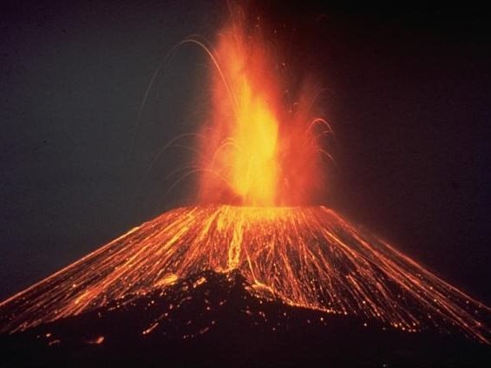

Eruption!

Slide 13
ELD Lesson Plan Creation: Eruption! p4-9
1. Grade 2-3. Unit theme: Volcanoes. Standard: 3. Function: Link text using temporal and cohesive words
2. Level 2: coor conj, adv of time/sequence
Level 5: subordinating conjunctions
3. Add the functions and forms to my curriculum map.
4. Text p4-9: L2: coor conj: but (p4, 6), and (p5, 6, 8, 9), or (p7)
adv of seq: at first (p8)
L5: sub conj: if (p6), because (p6), once (p9)
5. See Function/Form Analysis Chart
6. Level 2: Provide list of forms and sentence frames
  Level 5: Provide list of forms and sentence frames
  Students put pictures in order then tell their story to partner (who has different pictures)
  Student writes 1 paragraph story about a volcano erupting based on the photos and book
7. Observation of interaction, 1 paragraph story

Slide 14
Lesson Plan Creation: Eruption! p 10-14
1. Considering the theme of the unit, the materials, and the needs of your students, choose the function(s) for the unit: What will students DO with language?
2. Considering the level of your students—determine which forms they will need to be taught in order to accomplish the work.
3. Add each function and form to your personal curriculum map.
4. Examine your materials to see if the forms are present in them or if you will need to teach them directly.
5. Fill out Function/Form Analysis Chart
6. What tasks will the students do? (30 min)
(Receptive, Interactive, Productive)
  Teacher modeling
  Group or scaffolded practice
  Individual practice
7. How will I assess students’ learning?

Slide 15
Break

Slide 16
What Does Text Complexity Mean
for English Learners and Language Minority Students?
(Fillmore and Fillmore, 2012)

Slide 17
What Does Text Complexity Mean
for English Learners and Language Minority Students?
(Fillmore and Fillmore, 2012)
The language used in complex texts is difficult and cannot be learned through talking with native speakers, but only though working with the texts themselves.
It is especially critical that students have access to complex texts because after fourth grade, they serve as the vehicle for content delivery. (K-3: Learning to read; 4-12: Reading to learn)
Academic texts are marked by INFORMATIONAL DENSITY: every clause or phrase contains information critical to understanding the topic.

Slide 18
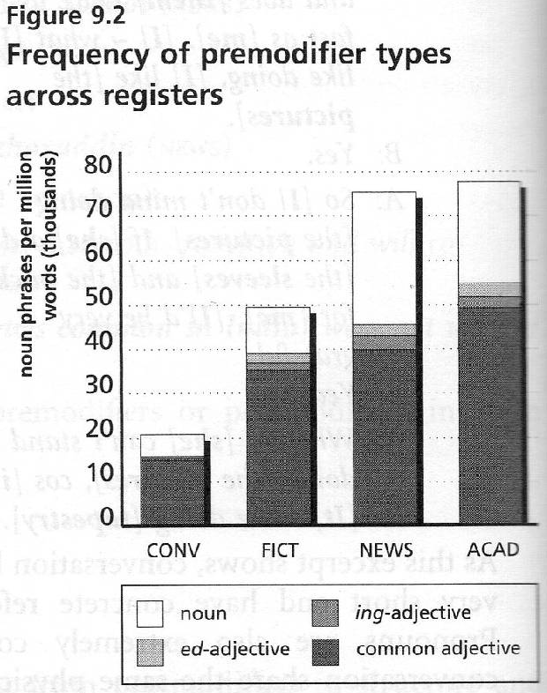
(Biber, Conrad, and Leech, 2002)

Slide 19
Strategy: Looking Closely at Language
One Sentence at a Time
Students do not necessarily need to learn the grammatical and linguistic terms related to complex texts, but they do need to learn how to understand the ideas found in such writing.
Planning is necessary: teachers must choose a sentence that is grammatically interesting and complex, and which contains ideas necessary for understanding the content.
The practice helps teachers engage their students in the “consciousness-raising” and “noticing” of language forms referred to by Larsen-Freeman (2014).
In the example cited by the authors, teachers engaged in the practice just 15-20 minutes daily.

Slide 20
One Sentence Analysis
The Secret Garden by Frances Hodgson Burnett
It was in that strange and sudden way that Mary found out that she had neither father nor mother left; that they had died and been carried away in the night, and that the few native servants who had not died also had left the house as quickly as they could get out of it, none of them even remembering that there was a Missie Sahib (p. 7).

Slide 21
One Sentence Analysis
The Secret Garden by Frances Hodgson Burnett
It was in that strange and sudden way that Mary found out that she had neither father nor mother left;
Mary found out that she had neither father nor mother left;
[in that strange and sudden way]

Slide 22
One Sentence Analysis
The Secret Garden by Frances Hodgson Burnett
Mary found out
that she had neither mother nor father left
that they had died and been carried away in the night
that the few native servants
who had not died
as quickly as they could get out of it
none of them remembering
that there was a Missie Sahib.
[WHAT DID SHE FIND OUT?]
[WHAT HAPPENED TO THEM?]
[AND?]
[WHICH ONES?]
also had left the house
[HOW DID THEY LEAVE THE HOUSE?]
[ANYTHING ELSE?]
[REMEMBERING WHAT?]

Slide 23
One Sentence Analysis
Eruption!
The rock that comes out of a volcano is called lava (8).
The rock [that comes out of a volcano] is called lava.

Slide 24
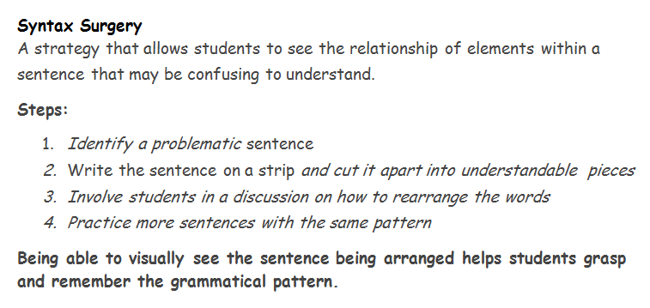
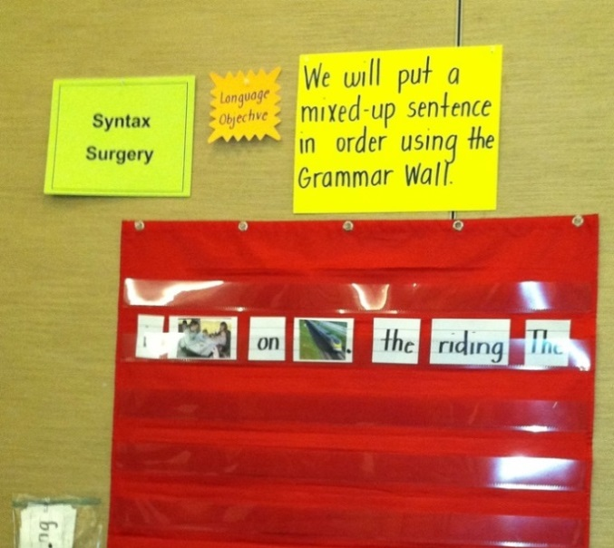
Video
Herrell & Jordan, 2012

Slide 25
Form and Meaning: Prepositional Phrases
The Most Frequent Prepositions?
A preposition + a noun phrase
While some of its articles are technical, requiring
an understanding of voice spectrograms, others are
accessible to anyone.

Slide 26
Form and Meaning: Prepositional Phrases
A preposition + a noun phrase
While some of its articles are technical, requiring
an understanding of voice spectrograms, others are
accessible to anyone.
1) post-noun modifier 2) sentence modifier

Slide 27
Prepositional Phrases in non-fiction
Horses were unknown in North America until the 1500s, when Spanish explorers began arriving. The explorers sailed from Spain with horses onboard their ships. They used the horses to explore the New World. During this exploration many of the horses were lost.
5th Grade History text

Slide 28
Prepositional Phrases in non-fiction
Horses were unknown in North America until the 1500s, when Spanish explorers began arriving. The explorers sailed from Spain with horses onboard their ships. They used the horses to explore the New World. During this exploration many of the horses were lost.
5th Grade History text
1) post-noun modifier 2) sentence modifier

Slide 29
Frequency of Prepositions
in Conversational vs. Academic English
Biber, Conrad, & Leech. 2002. Longman Grammar of Spoken and Written English.
# of Prepositions
per 1000 words

Slide 30
Prepositional Phrases
the 4 functions
prepositional phrases that tell
when, where, why, how,
how much, how long
prepositional phrases
that modify nouns
The teachers will finish at 4:30.
The students in the class are studying.
prepositional phrases
that link ideas
In addition, we will provide snacks.
prepositional phrases
that express attitude, point of view
To my surprise, it was a lot of fun.

Slide 31
Prepositional Phrases
the 4 functions
prepositional phrases that tell
when, where, why, how,
how much, how long
prepositional phrases
that modify nouns
We left
at midnight.
prepositional phrases
that link ideas
These kinds of questions are easy.
Take, for example, a rubber chicken.
In my opinion, that’s a great idea.
prepositional phrases
that express attitude, point of view

Slide 32
Prepositional Phrases
the 4 functions
Let’s see
where
the leaves grow
in students’ texts!
prepositional phrases that tell
when, where, why, how,
how much, how long
prepositional phrases
that modify nouns
prepositional phrases
that link ideas
prepositional phrases
that express attitude, point of view

Slide 33
Push-in Contextualized ELD
Looking Forward
Next Tuesday, Sept. 30
1. Bring any teaching materials in which you want to include some explicit language teaching.
2. Bring your Azar Grammar Chartbook.
3. Prepare for presentations for the last session (Oct 10).

