Slide 1
Break

Slide 2
Practices
Math
Science
Make sense of problems and solve them
Plan and carry out investigations
Use math and computational thinking
Reason abstractly and quantitatively
Analyze and interpret data
Construct arguments from evidence
Produce clear and coherent writing
Integrate, compare, and synthesize ideas from text
Build on the ideas of others and articulate one’s own ideas
ELA

Slide 3
Standards
Math
CCSS for math
ELA
CCSS for ELA
Science
NGSS for science
English Language Proficiency Standards
corresponding to ELA, Math, and Science Practices
K-12 ELA Standards and 6-12 Literacy Standards

Slide 4
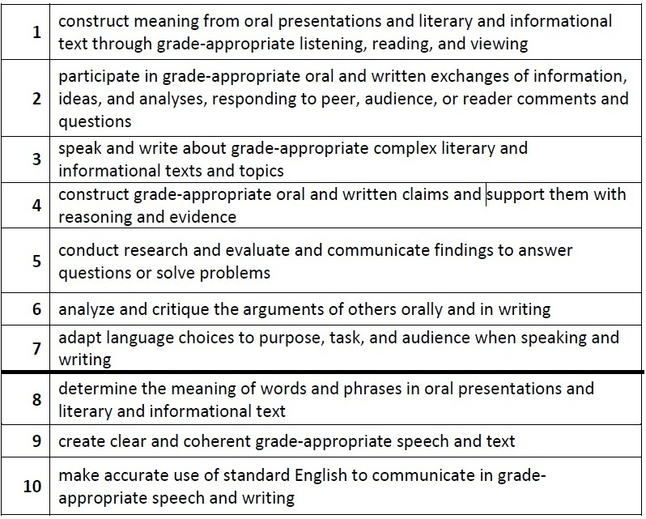
ELP Standards

Slide 5
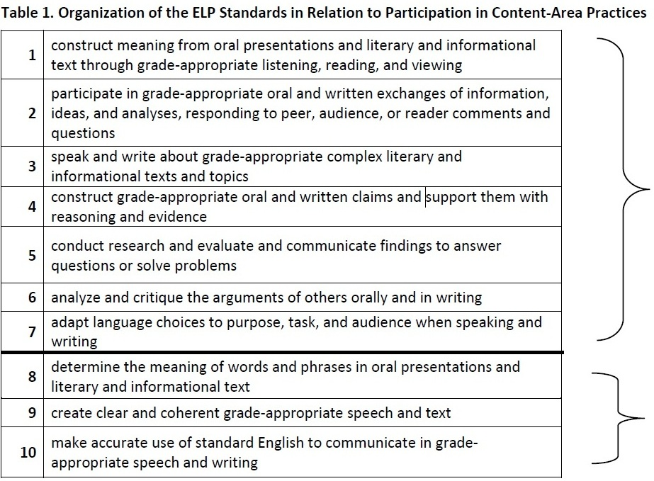
ELP Standards
Notes:
Standards 1 through 7 involve the language necessary for ELLs to engage in the central content-specific practices associated with ELA & Literacy, mathematics, and science. They begin with a focus on extraction of meaning and then progress to engagement in these practices.
Standards 8 through 10 hone in on some of the more micro-level linguistic features that are undoubtedly important to focus on, but only in the service of the other seven standards.
The ELP Standards are interrelated and can be used separately or in combination. (In particular, as shown above, Standards 8–10 support the other seven standards.) The standards do not include curriculum statements, nor do they privilege a single approach to the teaching of social and expressive communication or the teaching of grammar; instead, the standards and descriptors for each proficiency level leave room for teachers, curriculum developers, and states to determine how each ELP Standard and descriptor should be reached and what additional topics should be addressed.

Slide 6
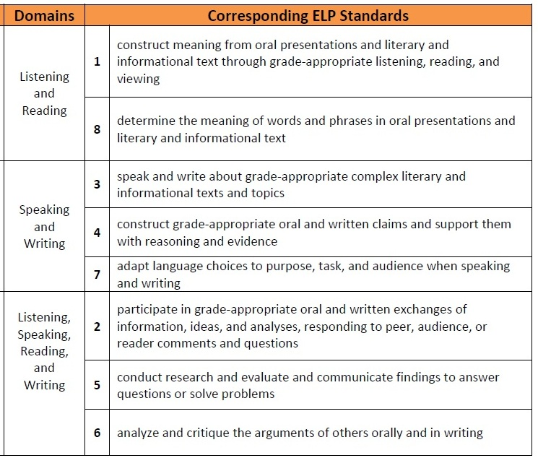
ELP Standards
Modalities
Receptive
Productive
Interactive
Notes:
Receptive modalities: This mode refers to the learner as a reader or listener/viewer working with ‘text’ whose author or deliverer is not present or accessible. It presumes that the interaction is with authentic written or oral documents where language input is meaningful and content laden. The learner brings background knowledge, experience, and appropriate interpretive strategies to the
task to promote understanding of language and content in order to develop a personal reaction.
Productive modalities: The mode places the learner as speaker and writer for a ‘distant’ audience, one with whom interaction is not possible or limited. The communication is set for a specified audience, has purpose, and generally abides by rules of genre or style. It is a planned or formalized speech act or written document, and the learner has an opportunity to draft, get feedback, and revise, before publication or broadcast.
Interactive modalities: Collaborative use of receptive and productive modalities. This mode refers to the learner as a speaker/listener [and] reader/writer. It requires two-way interactive communication where negotiation of meaning may be observed. The exchange will provide evidence of awareness of the socio-cultural aspects of communication as language proficiency develops.

Slide 7
Language Functions
refer
to things and information
create
songs, poems, stories, jokes
narrate
persuade
inform
describe
ask for information
ask for clarification
ask for agreement
express emotions and opinions
interpret
evaluate
summarize
generalize
interact socially
request
offer
paraphrase
introduce
predict
hypothesize
summon
greet
conclude
thank
forgive
apologize
congratulate
direct
advise
warn
threaten
refuse
complain
compliment
metalingual
to discuss and describe language

Slide 8
Which Functions do we need to teach?
refer
to things and information
create
songs, poems, stories, jokes
narrate
persuade
inform
describe
ask for information
ask for clarification
ask for agreement
express emotions and opinions
interpret
evaluate
summarize
generalize
interact socially
request
offer
paraphrase
introduce
predict
hypothesize
summon
greet
conclude
thank
forgive
apologize
congratulate
direct
advise
warn
threaten
refuse
complain
compliment
metalingual
to discuss and describe language

Slide 9
Language Functions in the ELP Standards
There is not an official list of 23 functions as in the previous ODE requirements. The new ELP standards use the following words more freely:
Receptive Interactive Productive
Identify,
Determine
Gather,
Label,
Record,
and Sort information
Participate
Follow rules
Answer
Ask questions
Contribute
Build
Respond
Express
Explain
Introduce & Conclude
Compose written narratives & informational texts
Deliver
Retell/recount
Adapt language choices
Expand and rearrange sentences
Link text using temporal and cohesive words

Slide 10
Language Functions and Forms
How might we describe the function of this passage?
Explaining—Informational text
Firefighters put out fires. They save lives. They stop fires from spreading. Without firefighters, a fire could damage a large area.
Firefighters also teach people how to prevent fires, or not let them happen. They say to throw away trash and other things that can catch on fire. “Fix old wires in the house. Don’t let children play with matches,” they say.
Firefighters visit schools. They tell students to make an escape plan at home. They show students how to quickly and safely leave a building that is on fire. What if your clothes catch on fire? “Stop, drop, and roll!” they say.
from Grade 2 text, Houghton Mifflin Harcourt (2014)

Slide 11
Language Functions and Forms
What are the formal properties of this text?
Firefighters put out fires. They save lives. They stop fires from spreading. Without firefighters, a fire could damage a large area.
Firefighters also teach people how to prevent fires, or not let them happen. They say to throw away trash and other things that can catch on fire. “Fix old wires in the house. Don’t let children play with matches,” they say.
Firefighters visit schools. They tell students to make an escape plan at home. They show students how to quickly and safely leave a building that is on fire. What if your clothes catch on fire? “Stop, drop, and roll!” they say.
from Grade 2 text, Houghton Mifflin Harcourt (2014)

Slide 12
Everyday speech vs. written language in school
Everyday speech
Vocabulary
most common verbs, nouns, adjectives, adverbs
Information Density
Short clauses
Simple or compound sent.
Verb-heavy
Few noun modifiers
Few verbal modifiers
Formal writing
Vocabulary
content words specific to the topic
Information Density
Longer clauses
Complex sentences
Noun-heavy
Many noun modifiers
Many verbal modifiers

Slide 13
Everyday speech vs. written language in school
Everyday speech
Vocabulary
most common verbs, nouns, adjectives, adverbs
Information Density
Short clauses
Simple or compound sent.
Verb-heavy
Few noun modifiers
Few verbal modifiers
Formal writing
Vocabulary
content words specific to the topic
Information Density
Longer clauses
Complex sentences
Noun-heavy
Many noun modifiers
Many verbal modifiers

Slide 14
Language Functions and Forms
Vocabulary of formal/academic writing
Firefighters put out fires. They save lives. They stop fires from spreading. Without firefighters, a fire could damage a large area.
Firefighters also teach people how to prevent fires, or not let them happen. They say to throw away trash and other things that can catch on fire. “Fix old wires in the house. Don’t let children play with matches,” they say.
Firefighters visit schools. They tell students to make an escape plan at home. They show students how to quickly and safely leave a building that is on fire. What if your clothes catch on fire? “Stop, drop, and roll!” they say.
from Grade 2 text, Houghton Mifflin Harcourt (2014)

Slide 15
Language Functions and Forms
Vocabulary of formal/academic writing
Firefighters put out fires. They save lives. They stop fires from spreading. Without firefighters, a fire could damage a large area.
Firefighters also teach people how to prevent fires, or not let them happen. They say to throw away trash and other things that can catch on fire. “Fix old wires in the house. Don’t let children play with matches,” they say.
Firefighters visit schools. They tell students to make an escape plan at home. They show students how to quickly and safely leave a building that is on fire. What if your clothes catch on fire? “Stop, drop, and roll!” they say.
from Grade 2 text, Houghton Mifflin Harcourt (2014)

Slide 16
Language Functions and Forms
Noun modification in formal/academic writing
Firefighters put out fires. They save lives. They stop fires from spreading. Without firefighters, a fire could damage a large area.
Firefighters also teach people how to prevent fires, or not let them happen. They say to throw away trash and other things that can catch on fire. “Fix old wires in the house. Don’t let children play with matches,” they say.
Firefighters visit schools. They tell students to make an escape plan at home. They show students how to quickly and safely leave a building that is on fire. What if your clothes catch on fire? “Stop, drop, and roll!” they say.
from Grade 2 text, Houghton Mifflin Harcourt (2014)

Slide 17
Language Functions and Forms
Adverbial modification in formal/academic writing
Firefighters put out fires. They save lives. They stop fires from spreading. Without firefighters, a fire could damage a large area.
Firefighters also teach people how to prevent fires, or not let them happen. They say to throw away trash and other things that can catch on fire. “Fix old wires in the house. Don’t let children play with matches,” they say.
Firefighters visit schools. They tell students to make an escape plan at home. They show students how to quickly and safely leave a building that is on fire. What if your clothes catch on fire? “Stop, drop, and roll!” they say.
from Grade 2 text, Houghton Mifflin Harcourt (2014)

Slide 18
Language Functions and Forms
Direct Quotations in formal/academic writing
Firefighters put out fires. They save lives. They stop fires from spreading. Without firefighters, a fire could damage a large area.
Firefighters also teach people how to prevent fires, or not let them happen. They say to throw away trash and other things that can catch on fire. “Fix old wires in the house. Don’t let children play with matches,” they say.
Firefighters visit schools. They tell students to make an escape plan at home. They show students how to quickly and safely leave a building that is on fire. What if your clothes catch on fire? “Stop, drop, and roll!” they say.
from Grade 2 text, Houghton Mifflin Harcourt (2014)

Slide 19
Language Functions in the ELP Standards
Functions: all are linguistic action verbs.
What can we have students DO during a lesson?
Receptive Interactive Productive
Identify,
Determine
Gather,
Label,
Record,
and Sort information
Participate
Follow rules
Answer
Ask questions
Contribute
Build
Respond
Express
Explain
Introduce & Conclude
Compose written narratives & informational texts
Deliver
Retell/recount
Adapt language choices
Expand and rearrange sentences
Link text using temporal and cohesive words

Slide 20
Example of Contextualized ELD
Fourth grade unit: Lewis and Clark
Original lesson:
Teacher models a short Readers’ Theater about Lewis and Clark
Class discussion of hardships of their journey
Students break into groups to write an introduction to their own readers’ theater. Each group has a different text. Some groups have an ELL.

Slide 21
Example of Contextualized ELD
Fourth grade unit: Lewis and Clark
Lesson with Contextualized ELD:
Teacher models a short Readers’ Theater about Lewis and Clark
The intro to the reader’s theater contains the sentence:
“Strong and dedicated Lewis and Clark are rafting wildly down the Columbia River.”
The teacher highlights the present progressive verbs throughout the reading by acting out their actions.
Class discussion of the specific actions shown and the hardships of the journey.

Slide 22
Example of Contextualized ELD
Fourth grade unit: Lewis and Clark
Lesson with Contextualized ELD:
Teacher breaks students into groups, some with an ELL, and gives each their reader’s theater passage to read.
Teacher pulls out ELLs into a group for ELD time while the other students work on another aspect of the readers’ theater or unit.
Teacher gives ELL group the sentence:
Strong and dedicated Lewis and Clark are rafting wildly down the Columbia River.
(adj) and (adj) Lewis and Clark are (ing-verb) (adverb) (prepositional phrase).
And the chart:
adjectives ing-verbs -ly adverbs prepositional phrases

Slide 23
Example of Contextualized ELD
Fourth grade unit: Lewis and Clark
Lesson with Contextualized ELD:
Teacher helps students contribute words and phrases to their chart to describe Lewis and Clark’s journey in their section.
Each ELL uses the sentence frame to write 3 sentences that could be used to introduce their readers’ theater.
ELLs return to their original groups with their introduction sentences. Each group chooses one of the sentences to introduce their readers’ theater.
Groups practice and present their readers’ theater.

Slide 24
Example of Contextualized ELD
Fourth grade unit: Lewis and Clark
Lesson with Contextualized ELD:
Challenges:
Keeping students focused and on-task.
Students will try to make silly sentences.
(adjective) and (adjective) Lewis and Clark are (ing-verb) (adverb) (prepositional phrase).
Tired and stinky Lewis and Clark are sticking deeply their fingers up their noses.

Slide 25
Example of Contextualized ELD
1. In this lesson, what did the ELLs DO with language (what function(s) did they practice explicitly)?
2. Examine your 10 ELP standards, which ones are met in this lesson?
3. In your Azar book, find and review “present progressive”.
4. Consider the sentence frame from the lesson:
(adjective) and (adjective) Lewis and Clark are (ing-verb) (adverb) (prepositional phrase).
5. Was this an appropriate ELD lesson for the early intermediate and 3 intermediate ELLs in this class?
6. What other positive ELL strategies were used in the lesson?

Slide 26
Steps in Lesson Plan Creation
1. Considering the theme of the unit, the materials, and the needs of your students, choose the function(s) for the unit: What will students DO with language?
2. Considering the level of your students—determine which forms they will need to be taught in order to accomplish the work.
3. Add each function and form to your personal curriculum map.
4. Examine your materials to see if the forms are present in them or if you will need to teach them directly.
5. Fill out Function/Form Analysis Chart
6. What tasks will the students do? (30 min)
(Receptive, Interactive, Productive)
Teacher modeling
Group or scaffolded practice
Individual practice
7. How will I assess students’ learning?

Slide 27
Graduate Credit
Do you want to take the class for credit?
2 graduate credits
Cost would usually be $50 per credit
Ask us for a syllabus and course registration form.
Notes:
8:45 SUSAN
Susan Griffin to discuss requirements and provide registration form

Slide 28
Looking Forward
Bring any teaching materials in which you want to include some explicit language teaching
Please read the Larsen-Freeman and Fillmore and Fillmore article downloadable from our website:
http://dantas-whitney.weebly.com/

