Slide 1



Push-in Contextualized ELD
Session 1. Friday, Sept. 12, 2014
1. Introductions
2. Reflection and Discussion: Previous ELD Model
3. Overview of Research on Pull-out ELD
3. ELLs in the classroom: Sheltered Instruction & ELD/ELP
4. Guiding principles for the new ELP Standards
6. ELP Standards: Practices - Functions - Forms
7. Example of Contextualized ELD Lesson
8. Steps in Lesson Plan Creation
9. ED 638 Syllabus
10. Looking Forward

Slide 2



Reflection and Discussion:
Previous ELD Model at Stayton Elementary School

Slide 3
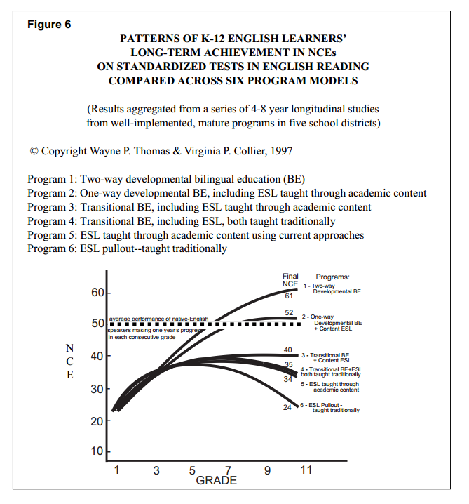

Slide 4
Limitations of the Pull-out Model
Instruction is delivered in small chunks of time. A limited amount of language can be learned in 30 minutes
Time is lost in the transition to another classroom
Students often miss important work during pull-out time
ELLs being pulled out are often stigmatized; may not be viewed as part of classroom community
Language instruction is disconnected to students’ content areas
(Reynolds et al., 2013)

Slide 5
Gardner (2013)
“… ELLs are often pulled out of the mainstream classroom to receive remedial help …, but the content of the remedial … class is not the same as the content of the classroom from which they were pulled out. A classic example is taking struggling science and math readers out of their classrooms, helping them to read Harry Potter of some other fictional text, and then sending them back into the science or math classroom to falter again" (115).

Slide 6
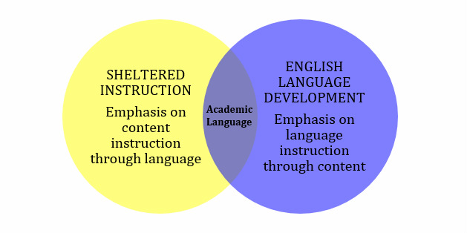
Sheltered Instruction and
English Language Development

Slide 7
Sheltered Instruction: Key Components
Sheltered instruction involves designing lessons that integrate language development and comprehensible content instruction. Sheltered lessons have two goals:
  to provide access to mainstream, grade-level content. This is achieved through scaffolding strategies.
  to promote language development. This involves carefully analyzing the language demands of the lesson and designing language objectives that will help students increase academic language proficiency.

Slide 8
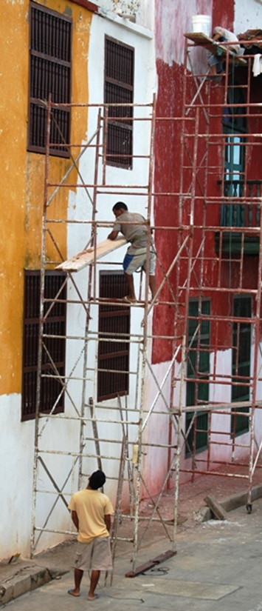
Scaffolding in Sheltered Instruction
Hands-on activities and cooperative learning
Written and oral instructions
Guarded vocabulary
  Contextual definitions of words and concepts
  Simplified vocabulary
  Repetition
  Shorter sentences and simpler syntax
  More pauses
Visuals, gestures and linguistic supports
  Graphic organizers, pictures, sketches
  Sentence frames, starters, transition words
  Primary language support and biliteracy development
Gradual release of responsibility
  Modeling, group practice, independent work
Take into consideration students’ …
  background experiences
  content knowledge
  language proficiency levels
Monitor, assess, and adjust

Slide 9
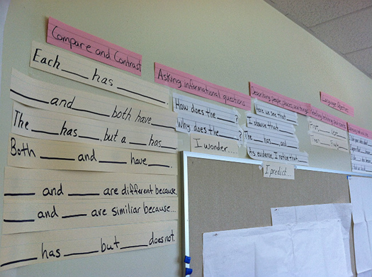
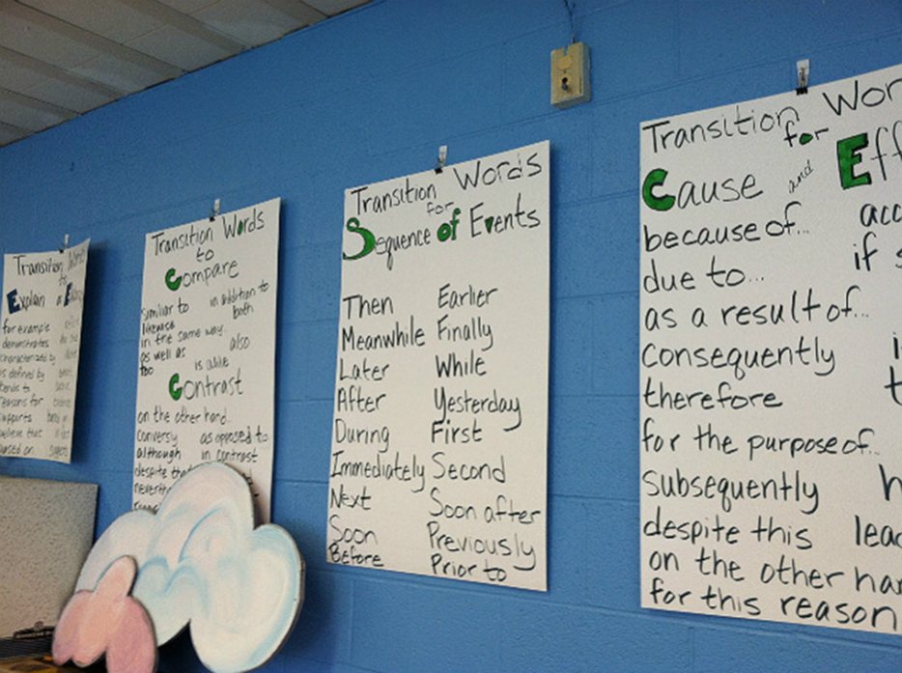
ELD: Key Components
Focus on helping English learners develop English language skills.
Taught as a separate subject area.
Language should not be taught in isolation. ELD should be linked to the content as well as the linguistic needs of the students.
ELP standards guide instruction. Lesson objectives are differentiated according to students’ language proficiency levels.
Focus on language in use, rather than knowledge about language.

Slide 10

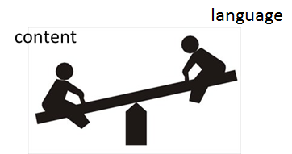
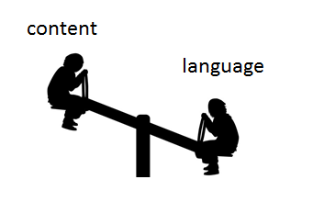
Models for ELD in the Content Classroom
ELD
Content
Teach new language
Recycle/review/practice familiar content
Use ELP standards to guide instruction
  Forms and Functions
  Differentiated instruction according to proficiency levels of ELL students
Teach new content
Recycle/review/practice familiar language
Use content standards to guide instruction
  Literacy, Science, Social Studies, Math
  “Sheltered strategies” used to make content accessible

Slide 11
Push-in ELD Model
During the ELD block…
  ELL students will stay in their homeroom
  ELD teacher will design lessons for ELLs in collaboration with classroom teachers
  ELD lessons will be developed using the ELP standards & utilizing content from other areas of the curriculum (e.g., literacy, science, social studies)
  Non-ELL students will be grouped in appropriate ways and work on relevant tasks during this period

Slide 12

Possible class formats…
Literacy block
ELD block
ELLs receive ELD contextualized instruction
All other students continue literacy rotations independently

Slide 13
Possible class formats…
Whole-group instruction
(e.g., GLAD unit)
ELD block
All students participate
ELLs receive contextualized ELD instruction
All other students work on relevant group tasks independently

Slide 14
Guiding Principles for the new ELP Standards
Potential of English Learners
Funds of Knowledge
Diversity in ELL Progress in Acquiring English Language Proficiency
Scaffolding
Students with Limited or Interrupted Formal Education
Special Needs
Access Supports and Accommodations

Slide 15
Funds of Knowledge Research:
The Project (Gonzalez, et al., 1993)
Gonzalez and her colleagues believe that the secret to quality instruction is for schools to investigate and tap into the "hidden" home and community resources of their students
The team of elementary teachers conducted a research project to uncover these resources in students’ homes
  Teachers went to students’ homes in order to learn (rather than to teach or for disciplinary reasons)
  Teachers met with university researchers in study groups to reflect on visits and develop relevant curriculum based on findings

Slide 16
The Findings
The home investigations revealed that many families had abundant knowledge that the schools did not know about--and therefore did not use in order to teach academic skills
The project made them look at the local households as “repositories of important social and intellectual resources for teaching” (p. 2).

Slide 17
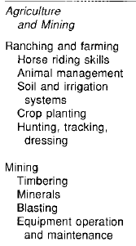
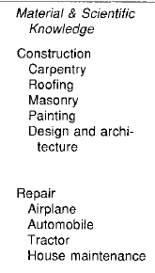
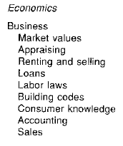
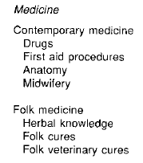

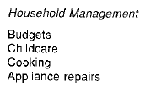
Table 1: A Sample of Household Funds of Knowledge

Slide 18
Ideas for Building the Home-School Connection by Tapping Funds of Knowledge
Teachers can be the “bridge”
between the school and the
home by validating their
students’ families and their funds of knowledge.
“Artist- or Craftperson-in-Residence” Programs (Ladson-Billings, 1995)
Parent-and-Child Co-authored Books (Ada, 1999)
Identity Texts (Cummins, 2006)

Slide 19
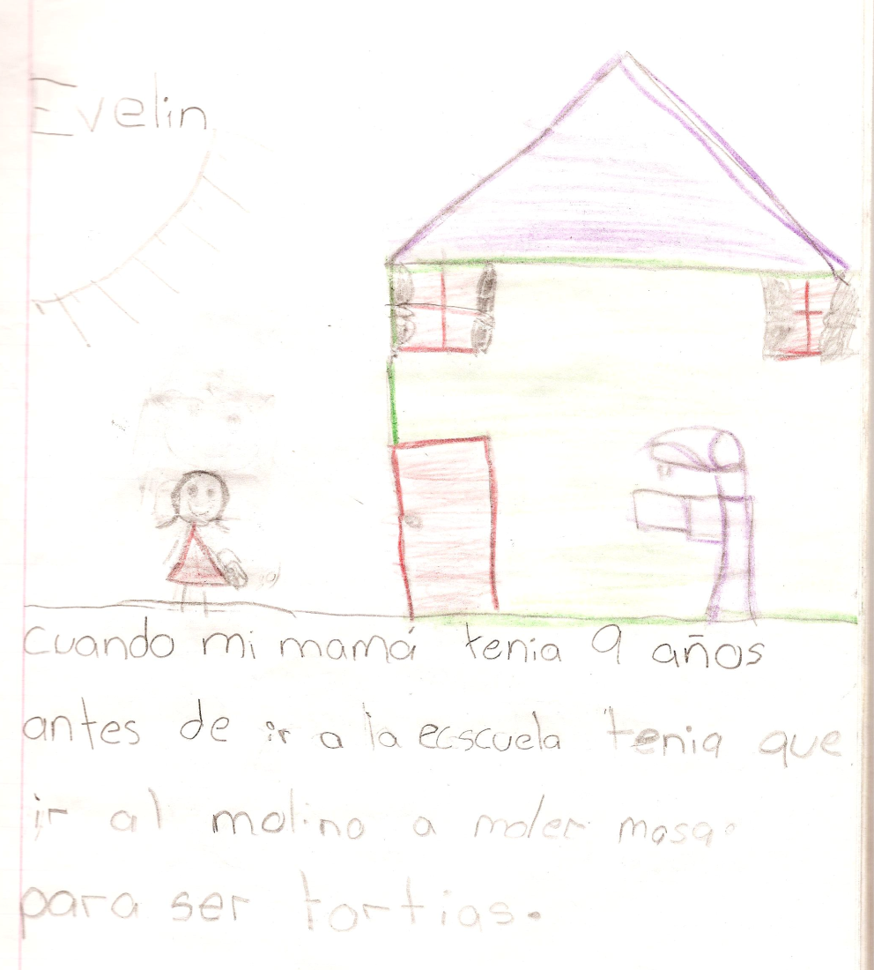
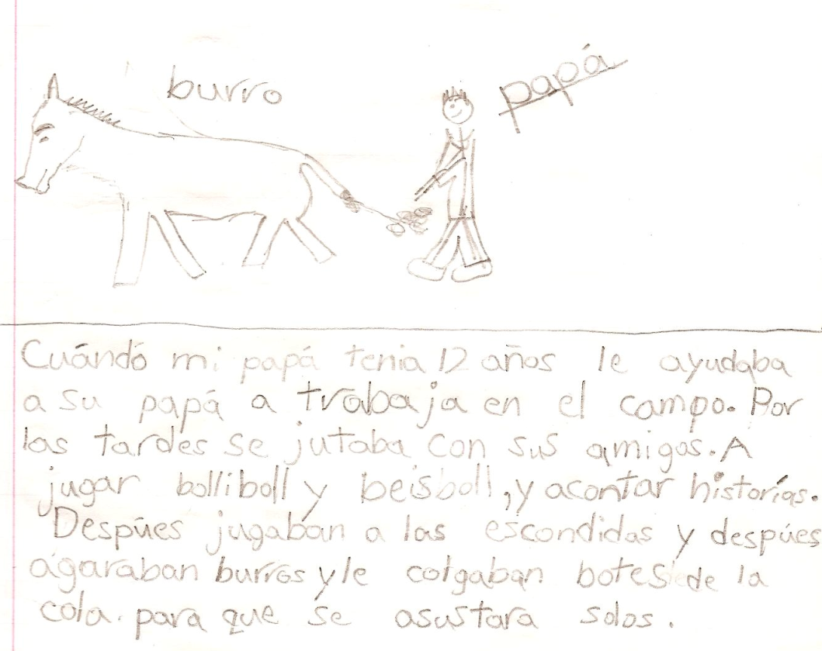
Family Journals to affirm Funds of Knowledge

Slide 20
Language Acquisition
We learn a language by unconsciously generating rules, not by imitating others.
Errors often indicate that learning is taking place.
Language is learned in meaningful, supportive and communicative settings.
We often understand more than we can say.
It takes a lot of time for us to become fluent.
Center for Applied Linguistics, 1999

Slide 21

Factors Influencing Second Language Acquisition
Psychological
Sociocultural
Age
L1 proficiency
Previous L2 experience
Personality (anxiety, confidence, self-esteem)
Motivation
Learning styles and strategies
Culture and status
Socioeconomic level
Parents’ literacy levels
Family/community involvement
Extra-curricular involvement
Peer group
Curriculum and instruction
Institutional policies
  Tracking
  Testing
  Physical Environment
  Disciplinary Policies

Slide 22
Additive vs. Subtractive Acculturation
Subtractive (assimilation)
Replacement of the old culture with the new
Reflects deficit perspective
Examples of school practices:
Additive
Acquisition of a new culture without rejection of the old
Reflects asset perspective
Examples of school practices:

Slide 23
Break

