Slide 1
CRITICAL ANALYSIS
Fostering EFL Learners’ Literacies Through Local Inquiry In A Multimodal Experience
Bettzy Castillo
Keyla Kennedy
Lisa Ramìrez
Gina Worrell

Slide 2
Research topic:
The ways in which community inquiries
Create opportunities for students
To explore social and cultural issues
In their neighborhoods using multimodality.

Slide 3
Comunity Based Pedagogy

Slide 4
Multimodality and CBP Multimodality…
*Mills (2011), “the modes are the starting point to develop new ‘grammars’ or a ‘metalanguage’ for a broader range of textual elements than linguistics (written words) alone”
*Using Social Networks as Tools for Communication in Foreign Language Learning Norton (2000)
Result: Generates endless opportunities in the EFL classroom for students to communicate.

Slide 5
What was the research approach chosen?

Slide 6
Action Reasearch Paradigm
It´s a methodology that combines action and research where findings are put into practice.

Slide 7
What? | Traditional Research | Action Research
Who? | University Professors, scholars on experimental and control groups | Teachers and Principals on their students.
Where? | Controlled variables enviroments. | Schools and Classrooms
How? | Quantitative methods to prove cause-effect relationship between variables. | Qualitative to describe what is happening and to understand the effects.
Why? | To report and publish conclusions for larger populations. | To take action and effect positive educational change in the school enviroment that was studied.

Slide 8
What type of research design was used?

Slide 9
Research Design.
This research was a combination of:
Ethnographic
Correlational
Descriptive
Mapping of the Students Communities
Interviewing
Pictures taken
Presentations of the community information
Surveys.

Slide 10
Who were the participants in this research? How were they selected and on what principles/rationales?

Slide 11
Social Stratification 1 and 2
May 2012 to February 2014
Public School with 2 Shifts 1600 population
South Bogota
Participants: 40 tenth graders 14-15 yo
To have them raise their low academic and disciplinary performance.
Engage them in literacy practices to help them improve their situation.

Slide 12
DATA COLLECTED
How was data collected and analyzed?
Grounded Approach.
ATLAS IT

Slide 13
Principles of multimedia learning
A. Words and pictures are better than words alone.
B. Multimedia learning is more effective when learner attention is focused, not split.
C. The presentation of multimedia content should exclude extraneous and redundant information.
D. Multimedia learning is more effective when it is interactive and under the control of the learner.
E. Multimedia learning is more effective when learner knowledge structures are activated prior to exposure to multimedia content.
F. Multimedia instruction that includes animation can improve learning.
G. Multimedia leaning is most effective when the learner is engaged with the presentation.

Slide 14
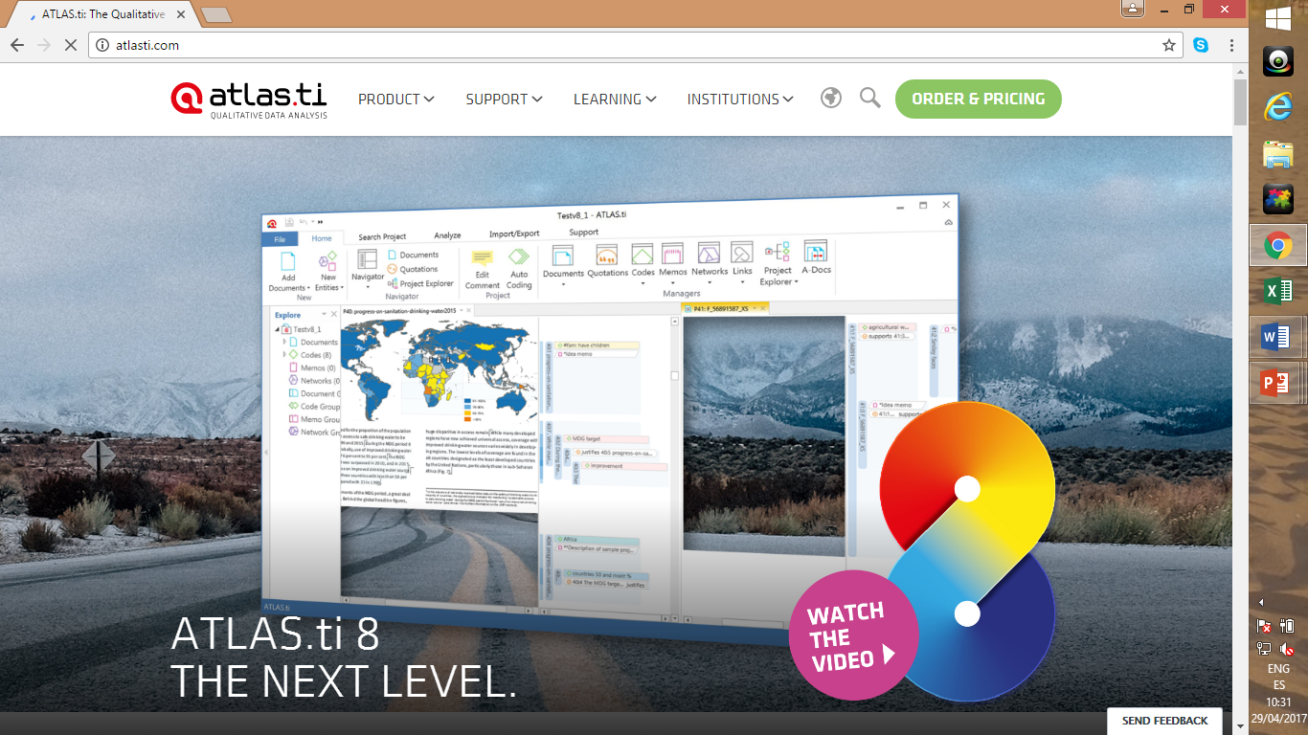

Slide 17
Were the methods of data collection appropriate (e.g., got the right kind of data required to answer the research questions)? Grounded Approach. ATLAS IT.
The ways in which community inquiries.
Create opportunities for students.
To explore social and cultural issues
In their neighborhoods using multimodality.
NOTE: ALL OF THEM APPLY TO GROUNDED APPROACH.

Slide 18
What other kinds of data collection methods should have been used?
Were the data analyzed systematically and appropriately to answer the research questions?

Slide 19
Results / Finding
After gathering data from students, blogs, video tapes recording of class debates and teacher’s field notes, July Andrea Rincon and Amparo Clavijo Olarte used to triangulate , valudate, and verify the evidence to draw appropriate conclusion.
Multimodality generates endless opportunities in the EFL classroom for students to communicate. Most schools are still dominated by traditional writing practices that praise the use of paper in which merely linguistic productions are promoted.
They also found that students developed skills through observation and identification of assets.

Slide 20
Students elicidated linguistic abilities in EFL, writing (literal, descriptive, interpretive, and argumentative) in Facebook and blog interaction through students texts, using both languages, Spanish and English.
Students inquieres in community mapping, community observation and the creative of question guides.
The finding were presented by reports,power points presentation, video, songs, and artistic creation, to inform the audience in English they strategically drafted the responses obtsined by business owners, computers room, to prepare the text and include the documents with picture and internet images.

Slide 21
The inquiry that student did in their communities help develop better and descriptive EFL texts and also achieve and analyze the level of EFL text.
The students represent their understanding of social and cultural issues through slides presentastion, songs creations,stories, photo galleries, video, scripted Voiceovers, music, and video clip from internet to create their reflections.

Slide 22
CONCLUSION
In conclusion teachers after looking into the students environment of public education discover the school as an asset students communities environment after remarkable opportunities for inquiry information gathering and and transformation of curricular practice to make EFL classes more meaninful.
It was discovered that students communities provides alternatives for creating meaninful learning environment in the EFL classroom, transforming mechanical and decontextualized language practice into flexible way to communicate what matters to students when they are intellectully and emotionally engaged with better learning is achieve.

