Slide 1
Are you digitized? Ways to provide motivation for ELLs using digital storytelling. - Tecnam Yoon
Presentation by: Nora, Katherine, Carmen, and Shadia

Slide 2
Topic/Questions/Literature
1

Slide 3
Topic: Digital storytelling in young ELL learners
Purpose: To investigate the effects of digital storytelling in young ELL learners’ attitudes and perception toward learning in English.
Questions:
How does digital storytelling work for the improvement of reading ability in young ELL learners?
In which ways does digital storytelling affect the changes of young ELL learners’ attitude in EFL English reading class?
Theoretical framework:
Provides complete definition/explanation of digital storytelling, as well as a comparison between oral storytelling and digital storytelling.
Principles of digital storytelling - “I AM TOP CAMP”
Notes:
Digital Storytelling: focused on human narratives using images, narration, and music to frame memories as powerful stories. Digital stories include a set of multimodal aspects and components such as visual images, written texts, recorded audio narration, music/sound and video clips/segments.
I AM TOP CAMP
Interactive, authentic, meaningful, technological, organized, productive, collaborative, appealing, motivating, personalized.

Slide 4
Research Approach and Design
2

Slide 5
Research Approach
Research Design
In this case, the researcher decided to mix both, qualitative and quantitative approaches
Context: South Korean Public Primary School - former industrial midsize city
Method: Questionnaire (quantitative) and reading review report (qualitative)
Participants: 32 Fifth grade students

Slide 6
Data Collection and Analysis
3

Slide 7
Research Instruments:
2 pre-/post- reading comprehension tests
Initial and final attitude questionnaire
Pre-/post- survey for affective domain
Lecture review report (thoughts, efficacy, and necessity of digital storytelling)
3 Student self-evaluation surveys (interest, learner participation, understanding, and self-confidence)
Researcher’s role:
The researcher designed and developed the digital storytelling program that was adapted into two 5th grade classrooms. He also created the instruments that were administered to the students and he analyzed the data received from the instruments.

Slide 8
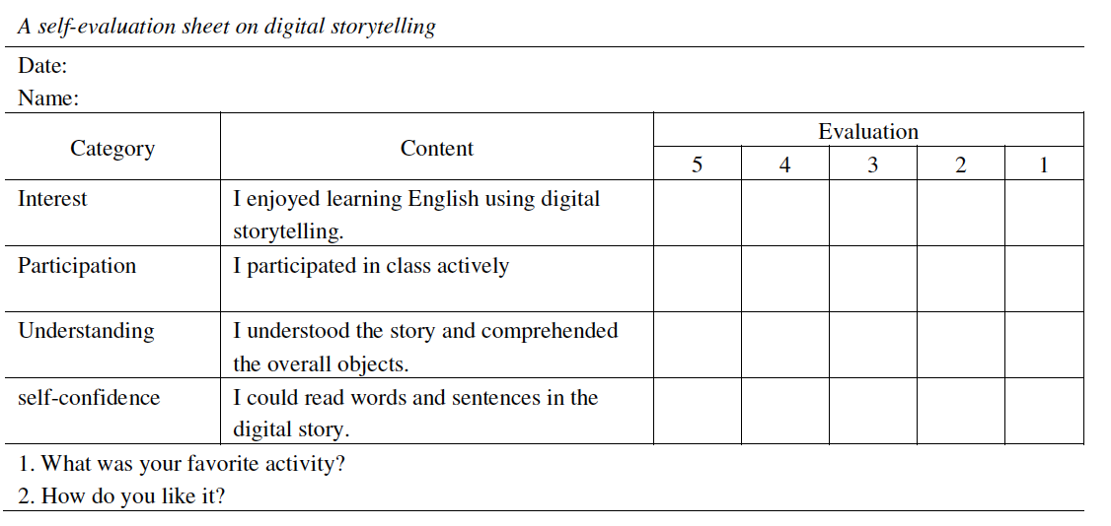
Notes:
1-5 Likert scale (strongly disagree to strongly agree)

Slide 9
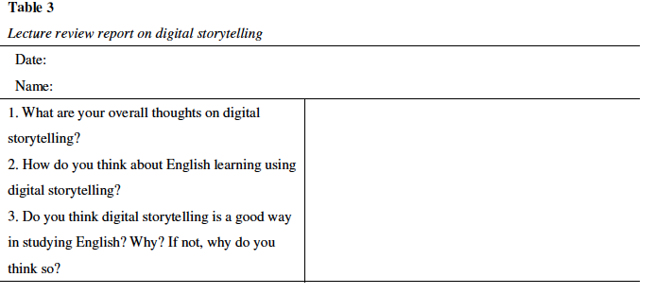

Slide 10
Connection to research questions:
How does digital storytelling work for the improvement of reading ability in young ELL learners?
There were positive changes in the student’s reading comprehension.
In which ways does digital storytelling affect the changes of young ELL learners’ attitude in EFL English reading class?
Students were very motivated to read books in English through digital storytelling, thus giving them more confidence and interest overall to read in English.
Data analysis methods:
Data triangulation was used to cover diverse viewpoints and to validate confidence in the findings.

Slide 11
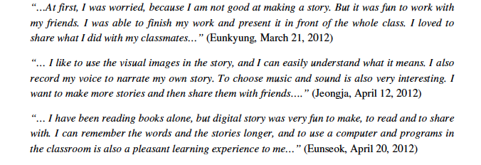

Slide 12
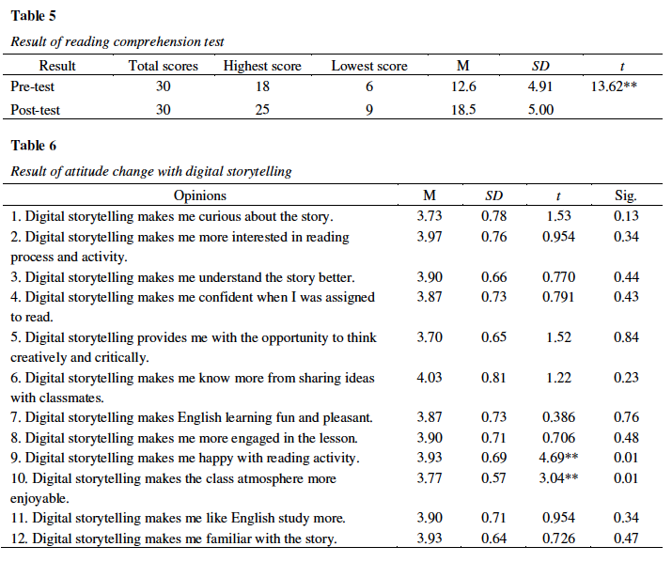

Slide 14
Findings
The results indicate that :
1) Digital storytelling showed positive effects on the improvement of students’ reading ability.
2) It made them engaged in the content of the story not only by promoting motivation and interest, but also by providing confidence in learning English.
3) It brought a sense of satisfaction and confidence to students who ended up being strongly motivated.
4) It helped students to have deeper understanding of the lesson, which led their voluntarily active class participation.
The findings showed that the potential benefits of digital storytelling brought positive effects on the 5th grade ELL students’ attitudinal changes in learning English by helping them to have deeper understanding of the lesson, which led their voluntarily active class participation. The results also revealed that digital storytelling made students engaged in the content of the story not only by promoting motivation and interest, but also by providing confidence in learning English.
4

Slide 15
Findings
Connections to the Literature and previous findings:
According to the literature, the concept of digital storytelling is focused on human narratives using images, narration and music to frame our memories as powerful stories, saying this there’s a connection between the theory and the practice of this research, which shows that actually it is a good way to improve students’ reading ability.
Limitations of the Study:
Age of participants.
Digital multimedia technologies suitable for the current students.
It focuses only on communicative / speaking abilities.

Slide 16
Conclusions, Recommendations, and General Critique
5

Slide 17
Conclusions/implications:
digital storytelling did have a significant, positive effect in the student's attitude and perception of English learning and reading.
Teacher training programs are required.
Improvement of multimedia facilities in schools.
Recommendations:
For future research,
More diverse training programs that involve technology and multimedia for in-service teachers may help them to acknowledge the advantages of this type of approaches in teaching ELLs.
Researcher suggests better technological infrastructure
A more natural environment would help in obtaining better results

Slide 18
General Critique:
Answered research questions?
How does digital storytelling work for the improvement of reading ability in young ELL learners?
As shown in table 5, including digital storytelling as part of reading and writing instruction helped ELL student learning considerably enhanced, clarifying that digital story was very effective in the sense that the students were all engaged in, and their attention was focused.
In which ways does digital storytelling affect the changes of young ELL learners’ attitude in EFL English reading class?
Young ELL learners can have a strong sense of motivation to learn English for communicative purposes.
Claims supported by data?
Yes, based on Yoon’s Research, claims are supported by data.

Slide 19
General Critique:
Author’s assumptions?
The author states that digital storytelling is something that can really motivate young ELLs for communicative purposes, although there are a few things to consider.
1) Teachers would require training on how to use this type of technology.
2) Multimedia improvements need to be made to many schools in order to have a better working environment.
3) Teachers need to understand that this approach is mainly for communicative purposes.
Practical use of research for you?
Yes, it is practical for teachers trying to motivate their students to read and speak more in English. We live in an age where students are highly motivated by the use of technology in the classroom.

Slide 20
Thanks!
Any questions?

