Slide 1
Sheltered Instruction for Secondary Teachers
Centennial School District
Maria Dantas-Whitney, Ph.D. – Western Oregon University – dantasm@wou.edu

Slide 2
Overview of Professional Development: LA & SS -- Math & Science
February 29 (LA & SS) March 1 (Math & Sci) 8am-3pm | Second Language Acquisition & School Expectations Components of Sheltered Instruction Academic Language Introduction to the ELP Standards Dimensions of Academic Language Grade-level teams: Examining the language demands of lessons Pairing content standards with ELP standards
March 14 (LA & SS) March 15 (Math & Sci) 8am-3pm | Designing Language Objectives for Content Lessons Creating Classroom Tasks for Academic Listening and Speaking Creating Classroom Tasks for Academic Reading and Writing Grade-level teams: Identifying appropriate language objectives (forms/functions) for lessons Designing tasks for academic listening, speaking, reading, and writing
May 10 8-11am (LA & SS) 12:00-3pm (Math & Sci) | Assessment Principles for ELs Differentiating Language Assessment Tasks According to ELs’ Proficiency Levels Classroom Assessment Tasks that Address Receptive (Listening and Reading) and Productive (Speaking and Writing) Modalities Teacher Presentations

Slide 3
Resources
Project website:
http://dantas-whitney.weebly.com/

Slide 4
Plans for Today
8-10am/12-2pm:
Reflection and Discussion: Assessment of English Learners
Mayra Gomez: Overview of EL Services at Centennial SD:
Identification, Placement, Testing, Exiting
Linguistic Demands and Cultural Validity of Assessments
A Multidimensional Approach to Assessment of ELs
Assessment Accommodations and Modifications
Differentiating Language Assessment Tasks According to ELs’ Proficiency Levels
Classroom Assessment Tasks that Address Receptive (Listening and Reading) and Productive (Speaking and Writing) Modalities
10-11am/2-3pm:
Presentations/Sharing of Lessons

Slide 5
Reflection and Discussion:
Assessment of Language Learners
Successes, Challenges, Questions

Slide 6
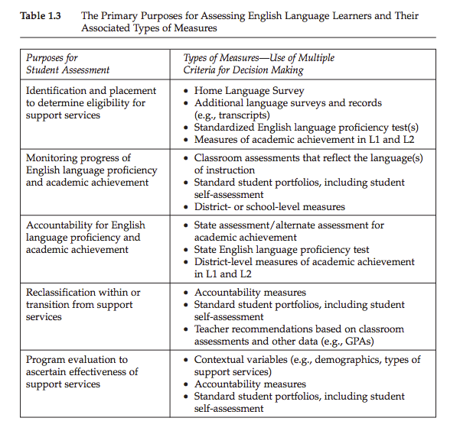
Primary Purposes for Assessing ELs (Gottlieb, 2006)

Slide 7
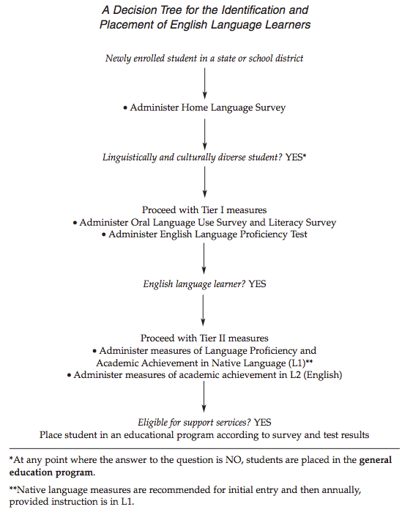
Brief Presentation by Mayra Gomez
Overview of EL Services at Centennial School District:
How are ELs…
identified and tested?
placed in classes?
exited from EL services?

Slide 8
Linguistic Demands of Assessments (Basterra et al., 2011)
The higher the “language load” of an assessment, the greater the gap in performance between native English speakers and English learners
Vocabulary
False cognates (actual in English means real; in Spanish means present-day)
Unfamiliar words (ream of paper)
Long words (fortuitousness; serendipity)
Syntax (Grammar)
Unfamiliar tenses (Dinosaurs might have succeeded in surviving if they had had enough time to escape the comet)
Long noun phrases (The first director of the newly developed organization)
Relative clauses (The young man whom Charles had met; the triangle that is below the square)
Prepositional phrases (Scott’s shirt is in the top drawer of the dresser in his bedroom)
Discourse
Lengthy problem statements or multiple step instructions
Passive voice (Six planks were placed over the stream by the farmer)
Poor cohesion across paragraphs (omission of transition words such as then, next)
These linguistic demands shape the way students understand and interpret assessments, and the ways they respond to them

Slide 9
Questions to ask
What does this assessment expect students to do with language?
What language proficiency does the student need in order to complete this assessment task?
How could I modify the language of this assessment question to make it more comprehensible to my students?
Many bird species on the Pitcairn Islands are in decline. In order to estimate the population of a particular species of bird, scientists mark 64 birds by attaching very small computer chips. A few days later, they catch 510 birds, 34 of which are marked with computer chips attached to them. To the nearest whole number, what is the best estimate for the bird population?
(Basterra et al., 2011)

Slide 10
Cultural Validity in Assessments
Students perform better on assessments that take into account their personal experience, prior knowledge, and cultural background
A child asked to write an essay describing herself may describe her entire family.
Is it because she did not read the directions accurately, or is it because in her culture
of origin it is unthinkable to talk about oneself to the exclusion of one’s family?
Four birds were sitting on a fence. A farmer threw a stone that hit one of the birds.
How many birds were left on the fence?
(Basterra et al., 2011)

Slide 11
A Multidimensional Approach to Assessment of ELs
Use a variety of assessment tools. A combination of assessments can capture student learning much more accurately than any single measure can
An ELL’s home language can be a powerful resource to make complex concepts comprehensible. Encourage students to use L1 as much as possible (e.g., note-taking, reasoning, bilingual dictionaries)
Use alternative assessments
Observations (anecdotal records, checklists, rating scales)
Journals
Portfolios
Self-assessments (checklists, rubrics, reflection prompts, e.g., “Today I learned…”)
Use assessment results to modify instruction
Communicate assessment results with students in clear and meaningful ways
Offer students opportunities to demonstrate knowledge in non-language dependent ways (e.g., graphic organizers, drawings, PowerPoint slides)
(Lenskie et al, 2006)

Slide 12
Accommodations and Modifications
Accommodation: the content of the standard remains the same, but the method for demonstrating mastery of that content may be adjusted
For example, to meet science standards, a student may require an audiotape of lectures in science class because of difficulty in taking notes. In addition, he or she might need to take a social studies end-of-unit assessment orally. Although the format for answering questions would be different, the content of the questions would remain the same, and the student would be judged, like all other students, on the content of his or her responses.
Modification: changing the standard itself
For example, a 9th grade English language learner's ELL plan may call for 7th grade vocabulary standards rather than 9th grade standards.
(Jung & Guskey, 2010)

Slide 13
Possible Assessment Adaptations for Beginning Els (Lenskie et al, 2006)
Permit students to answer orally rather than in writing
Allow a qualified bilingual professional to assist with the assessment
Consider offering the possibility of group assessments
Allow students to provide responses in multiple formats
Accept a response in the students’ native language if translation support systems exist in the school
Allow ELs to use a bilingual dictionary
Add glossaries in English or in the first language
Use visuals
Simplify assessment directions

Slide 14
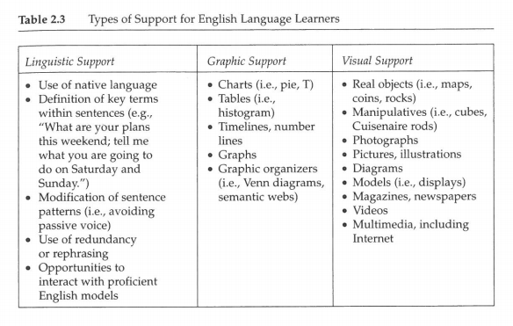
Types of Support for ELs in Assessments (Gottlieb, 2006)

Slide 15
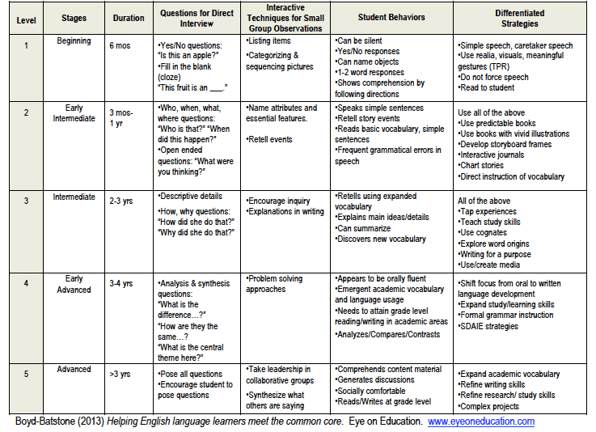
Classroom Assessment of Language Levels

Slide 16
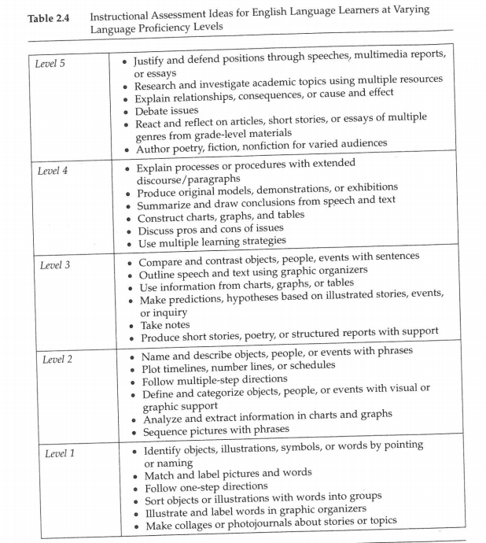
Assessment Ideas for Learners at Varying Proficiency Levels
(Gottlieb, 2006)

Slide 17
Aligning Assessment with Instruction for ELs
Read through the short article by Gordon (n.d.), Aligning Assessment with Instruction for English Language Learners
In groups, discuss how you align your own instructional practices to your assessments.
What are some practices you currently use?
What practices might you try in the future?

Slide 18
An important principle to remember…
ELD instruction should provide extensive input, and it should also give students opportunities for output and interaction.

Slide 19
Oracy and Literacy
R | ORACY |  | P
E |  |  | R
C |  |  | O
E | Listening | Speaking | D
P |  |  | U
T |  |  | C
I | Reading | Writing | T
V |  |  | I
E |  |  | V
 | LITERACY |  | E

Slide 20
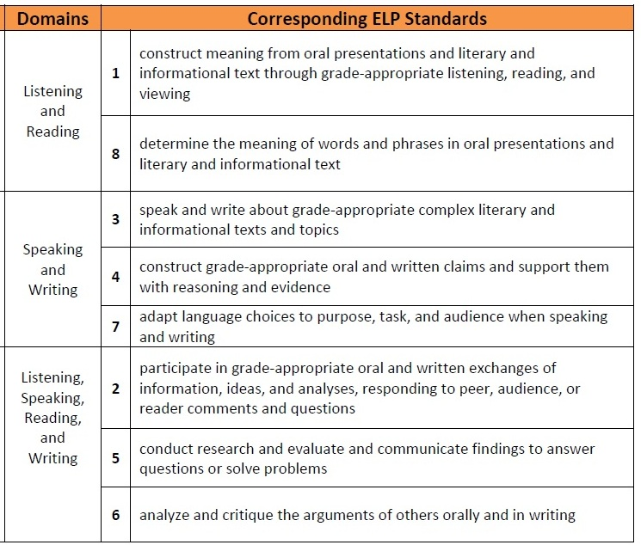
ELP Standards
Modalities
Receptive
Productive
Interactive

Slide 21
Some Ways to Assess ELs in Oral Language
observation during cooperative activities
picture-cued descriptions
book talks/story-telling/relating events
role plays/dramatizations
debates
interviews between students or between students and adults
presentations or reports based on research or content-based assignments
demonstrations on how to do activities or procedures
video production/digital stories with audio recordings
student-led conferences on original work or portfolios
What else?

Slide 22
Some Ways to Assess ELs in Reading and Writing
graphic organizers to classify words or phrases
sequencing pictures, sentences, or paragraphs
underlining or highlighting main ideas or supporting details
drawings or notes in reaction to readings
labels for figures, diagrams, illustrations
lists within authentic contexts (e.g., equipment for scientific inquiry)
brochures on content-based topics or classroom newsletters
expository paragraphs or essays
narratives – fiction or non-fiction
summaries
note-taking of lectures, outlining of text
structured reports (e.g., science labs)
multimedia presentations
notes, journals, and logs
portfolio of writing samples
What else?

Slide 23
Examine the unit you have developed …
Identify ways you may assess your ELs in these areas:
Oral Language (Listening and Speaking)
Reading/Writing

Slide 24
Lesson-sharing
You can present in groups or individually. Each presentation should last about 5-10 minutes.
Share the goals/objectives for your unit, and provide an overview of how you incorporated the ELP standards and some of the strategies/tasks/routines we have discussed
Choose one procedure/stage of one lesson to focus on. You can either demonstrate (“teach”) it to the group, or you can explain what you did.
Reflect on how things went, what you learned, successes, what you will do differently next time. How did your ELs perform in the unit?
If possible, share pictures of students performing your activities, sample materials, samples of student work, etc.

