Slide 1

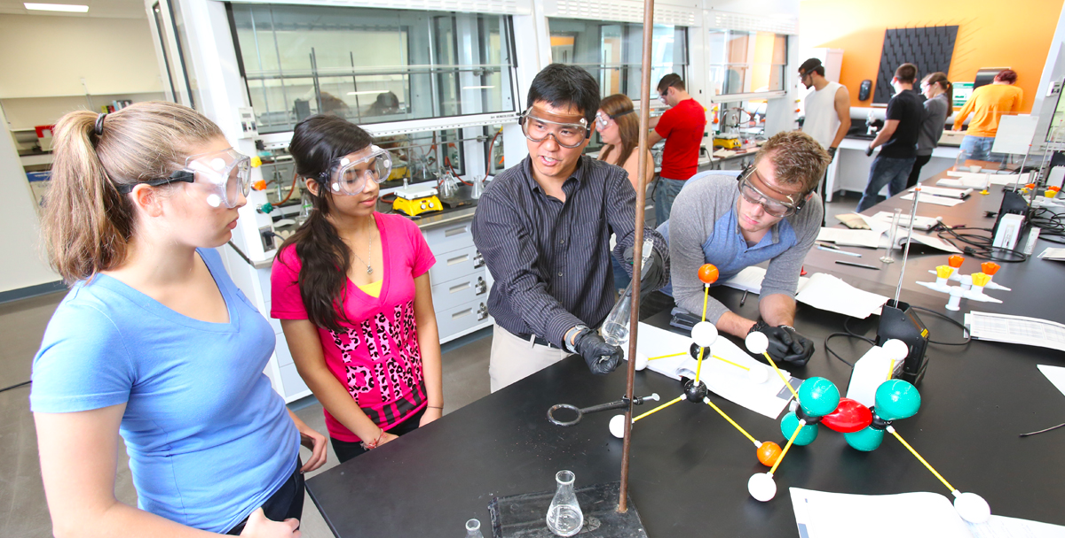

Sheltered Instruction for Secondary Teachers
Centennial School District
Maria Dantas-Whitney, Ph.D. – Western Oregon University - dantasm@wou.edu

Slide 2
Overview of Professional Development:
Math & Science
Day 1: March 1 (8am-3pm) | Second Language Acquisition & School Expectations Components of Sheltered Instruction Academic Language Introduction to the ELP Standards Dimensions of Academic Language Grade-level teams: Examining the language demands of lessons Pairing content standards with ELP standards
Day 2: March 15 (8am-3pm) | Designing Language Objectives for Content Lessons Creating Classroom Tasks for Academic Listening and Speaking Creating Classroom Tasks for Academic Reading and Writing Grade-level teams: Identifying appropriate language objectives (forms/functions) for lessons Designing tasks for academic listening, speaking, reading, and writing
Day 3: May 10 (12:00-3pm) | Authentic Language/Content Assessment Classroom Assessment Tasks that Address Receptive (Listening and Reading) and Productive (Speaking and Writing) Modalities Differentiating Language Assessment Tasks According to ELLs’ Proficiency Levels Teacher Presentations

Slide 3
Check-in
Introductions of new participants
Reflections from last session

Slide 4
Resources
Project website:
http://dantas-whitney.weebly.com/

Slide 5
Plans for Today
Designing Language Objectives for Content Lessons
Classroom Strategies and Tasks
  Facilitating class discussions
  Listening and speaking in small groups and pairs
  Reading complex texts
  Creating complex texts
Grade-level teams:
  Identifying appropriate language objectives (forms/functions) for lessons
  Designing tasks for academic listening, speaking, reading, and writing

Slide 6
Observation Charts
In pairs, examine the visuals
Discuss:
  Observations
  Reflections
  Connections
Record questions, phrases, words and/or sketches on blank paper

Slide 7
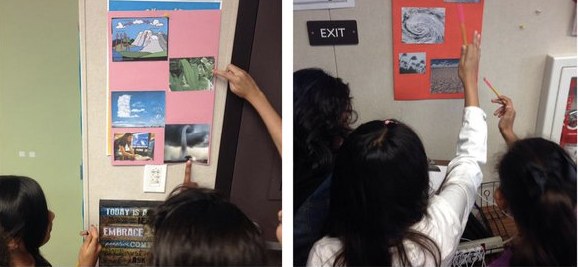
Debriefing: Observation Charts
Groupings of pictures related to the unit
Students work in pairs to write or draw their observations or questions on paper next to the charts.
  Teacher models how the observation chart works and the expectations for student participation (e.g., one writing utensil per pair, discuss together with partner, write/sketch what they see).
  There are an adequate number of observation charts around the room so students are not crowded.
  Working in pairs, students circulate and talk to their partner about the charts.
  Students record words and/or sketches on blank paper provided by the pictures.
  Once the activity starts, teacher turns “control” over to the students, while still monitoring their participation.

Slide 8
To recap… Dimensions of Language
Dimensions | Features | Skills
Discourse Level | Clarity and coherence Register for participants and purposes Density of ideas and their relationships Message organization and structure | Create a logical flow of and connections between ideas Match language with the purpose of the message (clear, complete, focused, logical) Create, clarify, elaborate, and negotiate ideas
Sentence Level | Sentence structure (compound/complex) and length Transitions and connectors Verb tenses, passive voice Pronouns and references | Craft sentences to be clear Use a variety of sentence types to clarify a message and condense information Combine ideas, phrases and clauses
Word/Phrase Level | Academic vocabulary (general, specialized and technical) Multiple meanings Prefixes, suffixes, roots, transformations | Choose and use the best words and phrases to communicate Figure out the meaning of new words and terms Use new words to build ideas or create products
Zwiers et al, 2014

Slide 9
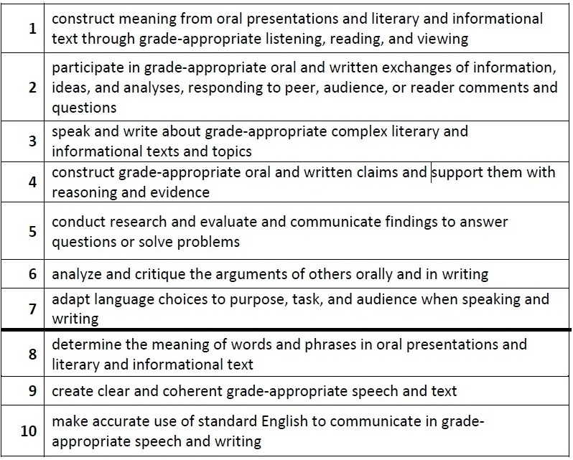
English Language Proficiency (ELP) Standards

Slide 10
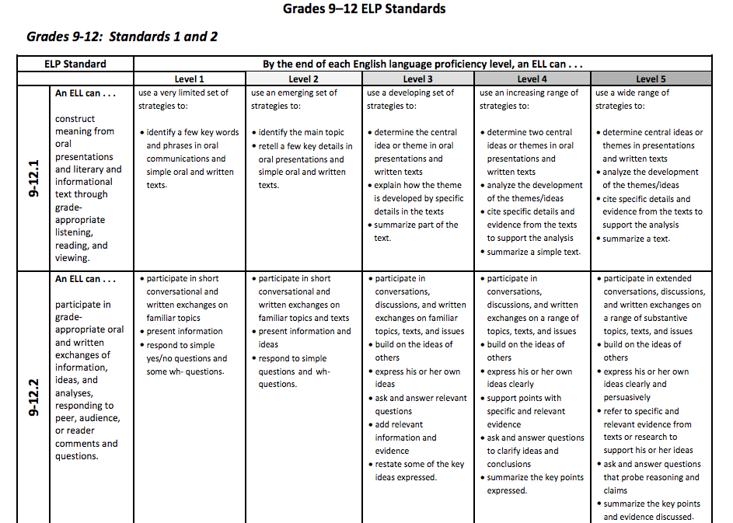
ELP Standards by Grade Level

Slide 11
Academic Language Functions

Slide 12
Language Targets
ELP Standards: Expectations for language performance
Dimensions of Language: Analysis of talk, texts, tasks, and tests in the unit
Language functions (e.g., describe, compare/contrast, proposition/support)
Language forms (e.g., complex sentences, transition words, adjectives)
talk (oral – speaking and listening) | texts (written – reading and writing)
tasks (interaction, projects, products) | tests (formative and summative assessments)

Slide 13
Examples of Language Targets
Students will be able to describe the characteristics of liquids, solids, and gases using present tense statements.
Students will be able to appropriately sequence the steps in solving a given quadratic equation by using time/sequence transitional words/phrases (e.g., first, next, then).
language function
(discourse level)
language forms
(sentence and word levels)
language function
(discourse level)
language forms
(sentence and word levels)

Slide 14
Differentiating Language Demands
The Language Function “Explain” in a Math Lesson
ELP level 1 | Explain by labeling fractional parts, using diagrams or realia, in conjunction with words/phrase banks
ELP level 2 | Explain what the fractional parts mean, using diagrams or realia, in conjunction with phrases or short sentences
ELP level 3 | Explain step-by-step process for solving problems involving fractions using diagrams in conjunction with a series of related sentences
ELP level 4 | Explain strategies for solving problems involving fractions using diagrams in conjunction with paragraphs
ELP level 5 | Explain difference in solving problems involving fractions for different real-world scenarios or situations
Gottlieb & Ernst-Slavit, 2014

Slide 15
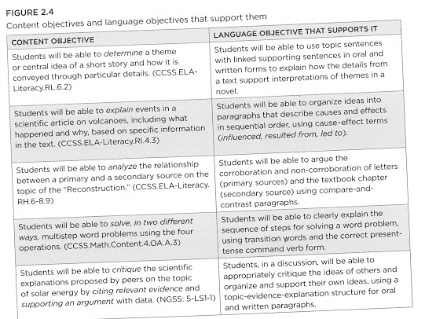
Pairing Content and Language Objectives

Slide 16
Planning a Unit around Academic Language Use
Key features of effective instruction:
  Clear goals and objectives/learning targets
  Appropriate and challenging material
  Clear input and modeling
  Structured, focused interactions with other students
  Application of new learning and transfer to new situations
  Active student engagement and promotion of agency/identity – students develop capacity to guide their own learning
  Practice and periodic review
  Frequent feedback, assessments, with re-teaching as needed
ELs benefit from having:
  Additional instructional supports (e.g., visuals, graphics, word banks, sentence starters)
  Ample opportunities for classroom interaction
  Use of home language to clarify and extend conceptual understanding
Gottlieb & Ernst-Slavit, 2014

Slide 17
Classroom Strategies and Tasks
Facilitating class discussions
Listening and speaking in small groups and pairs
Reading complex texts
Creating complex texts

Slide 18
Class Discussions
Researchers have found that 85% of instructional time in a sample of 8th and 9th grade classrooms was a combination of lecture, recitation, and seatwork (Nystrand & Gamoran, 1991)
However, natural discourse in career settings tends to be circular and exploratory, with lots of questioning, disagreeing, clarifying, etc. (Gilles, 1993)
Benefits of class discussions:
  Allow for repetition of linguistic terms and thinking processes and acquisition by students
  Push students to think quickly, respond, organize their thoughts into sentences, negotiate meanings, problem-solve, back claims with evidence, ask for clarification, and build knowledge through interaction
  Provide a format to make hidden thought processes more public and shared
  Allow for students to see how others think and use language to describe their thinking. Students compare their own thinking processes and interpretation to those of others

Slide 19
Academic Conversations
Academic conversations are:
  sustained
  purposeful
  content-rich
Core skills:
  Elaborate and clarify
  Support ideas with examples
  Build on or challenge a partner’s ideas
  Paraphrase
  Evaluate and compare
  Synthesize

Slide 20
Analyzing Academic Conversations
Eighth Grade Science Classroom
[transcript 1]
What are the rules of interaction?
Who can speak and when?
What do you notice about “sentences” and words?
Does the teacher support development of any core skills? If yes, which ones?

Slide 21
Recommendations for Teacher Talk
Initiation-Response-Evaluation (IRE) discourse often dominates classroom interaction
Need to:
  Move from IRE (evaluation) to IRF (Initiation-Response-Feedback) to offer students alternative interactional moves (e.g., revoicing, reasoning, adding on)
  Offer more open-ended topics for discussion, provide greater independence to students, and opportunities for greater output

Slide 22
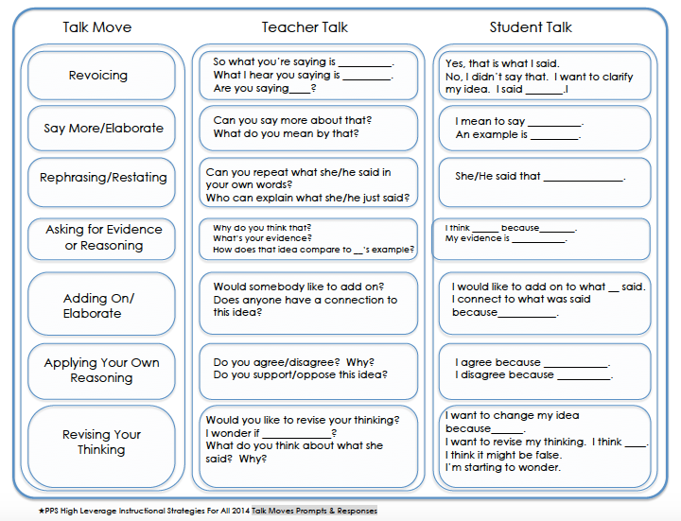
Productive Talk Moves

Slide 23
Analyzing Academic Conversations
Eighth Grade Science Classroom
[transcript 2]
What are the rules of interaction?
Who can speak and when?
What do you notice about “sentences” and words?
Does the teacher support development of any core skills? If yes, which ones?

Slide 24
Recommendations for Student Talk
Provide clear and explicit instructions
Make talk necessary for assigned task
Assign a clear outcome for the group
Determine if a task is appropriate to students’ cognitive and linguistic abilities
Involve all students in the group
Allow students ample time to complete the task and talk
Teach students how to work in groups together (provide rules and expectations)
Explicitly model and practice the core skills of academic conversations

Slide 25
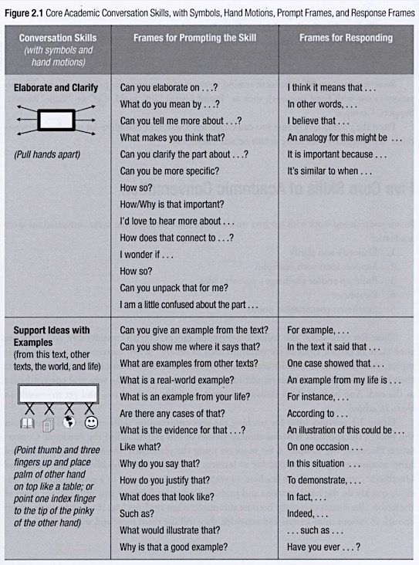
Zwiers & Crawford, 2011

Slide 26
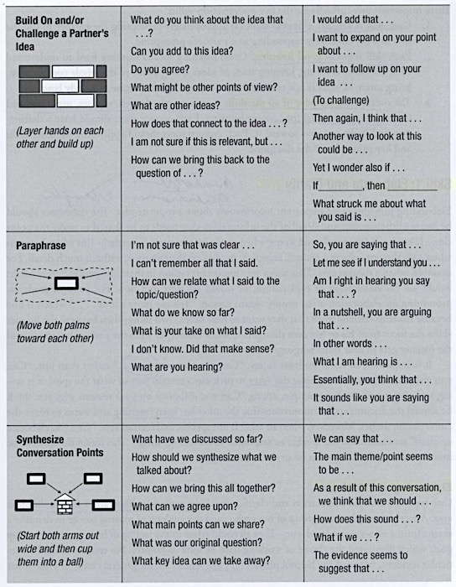
Zwiers & Crawford, 2011

Slide 27
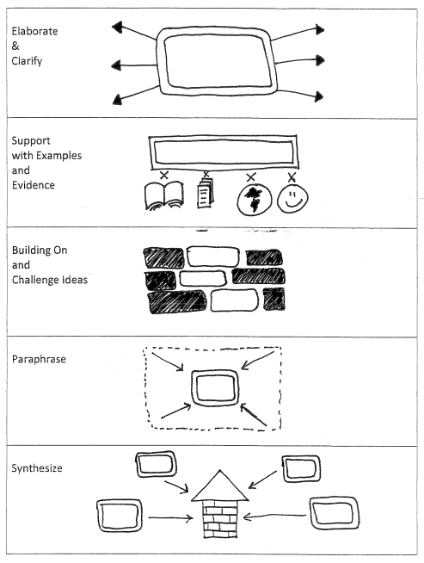

Slide 28
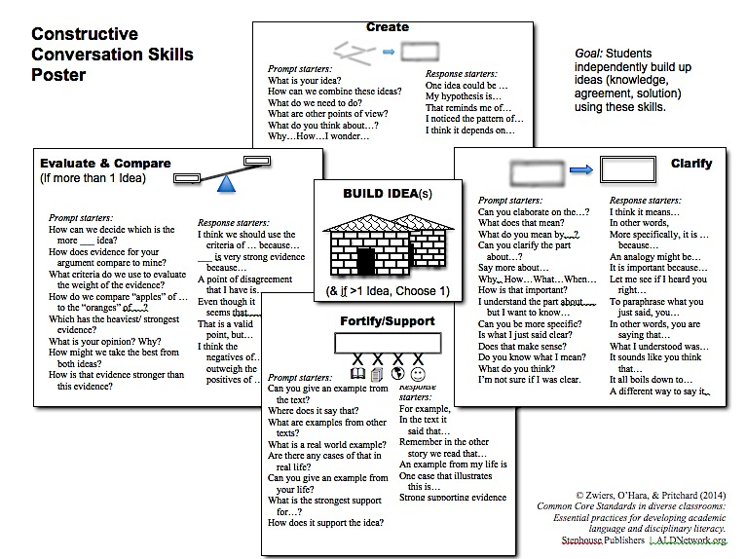

Slide 30
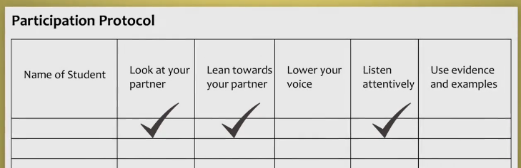
Videos: Talk Moves and
Participation Protocol
Talk Moves: Middle School ELD Class
https://www.teachingchannel.org/videos/analyzing-complex-texts-ells-ousd
Participation Protocol: Middle School Language Arts
https://www.teachingchannel.org/videos/participation-protocol-ousd

Slide 31


Slide 32
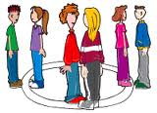

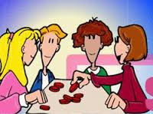
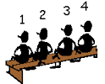

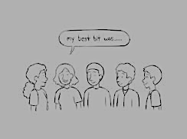

Structured Oral Practice Routines
Inside/Outside Circle -- Lines of Communication
Talking Stick -- Talking Chips
Numbered Heads Together
Think-Pair-Share
Stay and Stray
  Whip Around

Slide 33
Listening and Speaking in Small Groups
Advantages of Using Groups
Challenges of Using Groups
Maximize student talking time
Chances to construct opinions, defend them, challenge preconceived ideas, try new perspectives
Low stress opportunities to practice language
Teachers can:
  Model, scaffold, monitor, and assess learning
  Work with smaller groups and build relationships with students
Behavior problems
Noise
Inefficient use of time

Slide 34
Designing and Supporting Academic Groups
Group tasks should:
Be content-based an integrated with a broader curriculum topic
Have a clear outcome and an authentic engaging purpose
Challenge students to use higher-order thinking skills
Recycle academic language (vocabulary and ways of connecting ideas)
Involve all learners in the group to share in the task and its language
Generate ways in which low-academic status students can contribute
Encourage cooperation, rather than competition

Slide 35
Language for Working in Groups
Motto: “Respect, Connect, Build, and Support”
Teach students to listen and use phrases such as:
That’s a good point, but I disagree because….
I would like to build on what [name] said...
True, but what about...?
Similar to what [name] said, I think that...
However, one question I still have is ...
I’m interested in what [name] has to say...
We have been focusing a lot on ...., but we also need to talk about ...
What kind of evidence is there for that?
What else should we consider?

Slide 36
Language for Working in Groups
A Good Academic Speaker | A Good Academic Listener
Maintains eye contact Uses gestures and facial expressions to emphasize points Varies voice tones and volume to emphasize points Pauses to let the listener process information Pauses to let the listener respond Checks to see if the listener understands Stays on topic | Maintains eye contact Nods head and uses facial expressions to support speaker Responds with conversation continuers, such as wow or interesting Waits for appropriate pauses to talk Asks probing questions to clarify and have the speaker elaborate, give examples, provide evidence Paraphrases what the speaker is saying to show understanding and to clarify

Slide 37
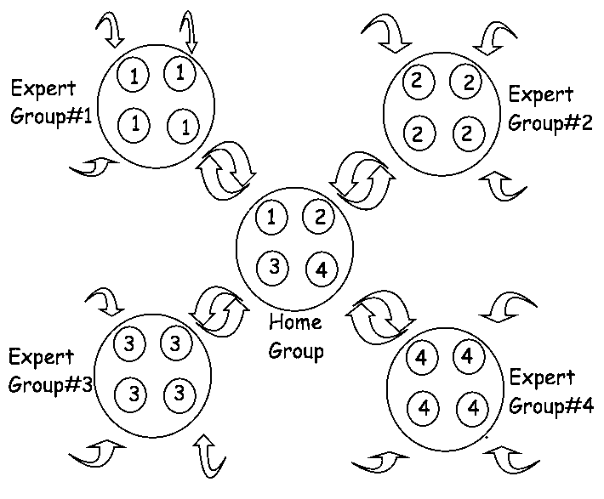
Group Activities
Jigsaw
Interview Grids
Name | Compare bird and insect adaptations | Explain how crocodiles have adapted | Argue why dinosaurs became extinct
Julia
Ken
Toshiko

Slide 38
Group Activities
Information Gap
Student-prepared conversation cards (based on reading different texts)
A
Emma wants to pint the four walls of her room. But she isn’t sure if she has enough money to buy the paint. Does she have enough?
B
The floor of Emma’s room is 12 feet by 10 feet. The walls are 8 feet tall. A gallon of paint covers 100 square feet. A gallon costs $24. Emma has $75.
Card A | Card B
We don’t know the potential effects on ecology or on the health of humans Man-made cells might allow bioterrorists to create deadly new viruses | The man-made cells might be used to create vaccines Humans throughout history have gained control of nature, such as the creation of antibiotics

Slide 39
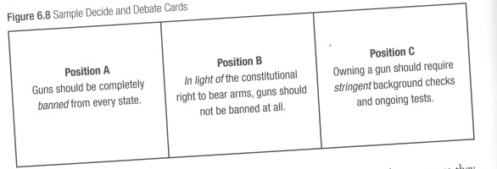
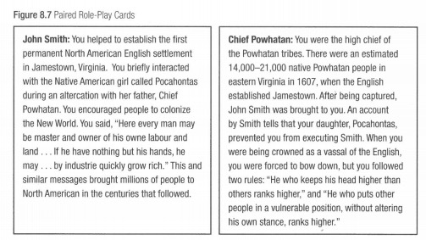
Group Activities
Role plays and Debates

Slide 40
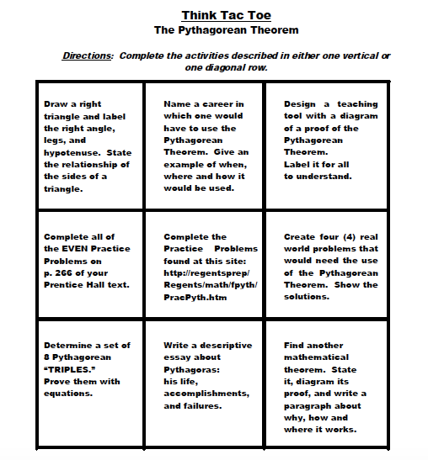
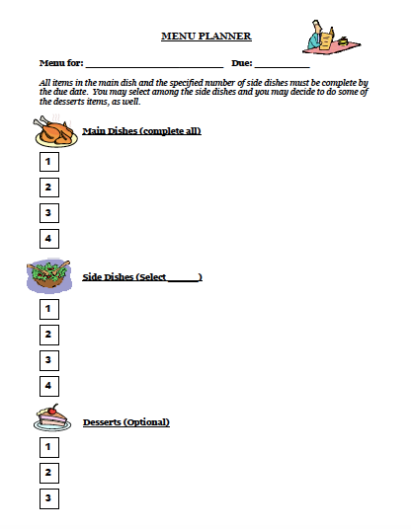
Group Activities
Learning Menus and Choice Cards

Slide 41


