Slide 1
Sheltered Instruction for Secondary Teachers
Centennial School District
Maria Dantas-Whitney, Ph.D. – Western Oregon University - dantasm@wou.edu

Slide 3
Reading Complex Texts
Read-Aloud
Comprehend-Aloud
Build students’ interest in a text
Develop academic listening skills (e.g., discriminating important form unimportant information)
Develop abilities to handle longer and more complex sentences
Build up knowledge needed for class and group discussions
Noticing academic language and thinking (Ramifications means effects)
Identifying confusing parts and clarifying them (I’ll read ahead a few lines and see if it becomes clearer)
Making predictions, connecting text to other texts, world issues (This reminds me of the movie I saw)
Describing how each part of the text supports its main theme (The author used this quotation to show how the government brainwashed people)

Slide 4
Before-During-After (BDA)
Before-reading | During-reading | After-reading
Build background knowledge Relate to students’ lives Pre-teach vocabulary and concepts Examine text organization Modify the text to make it accessible for ELLs (e.g., highlighting, drawing diagrams, adding notes in native language, making an audiotape) | Using Headings and Subheadings Vocabulary Strategies/Clustering Jigsaw Procedure Learning Logs Graphic Organizers Illustrating Stories and Poems/Story Mapping | Journals/learning logs Photo essays Written and oral collaborative research projects Developing Scripts for Readers’ Theater Adapting Stories into Plays and Film Scripts

Slide 5
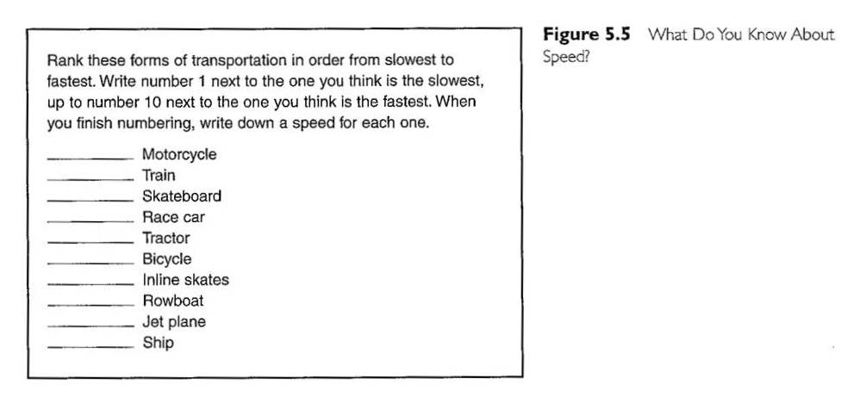
Anticipation Guides

Slide 6
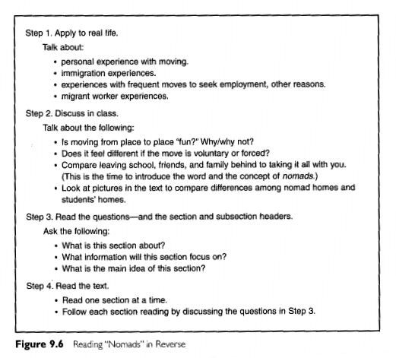
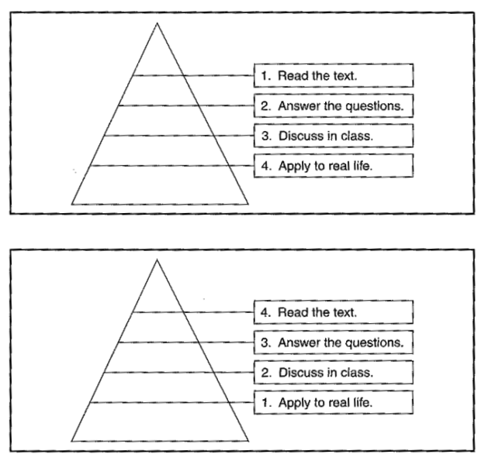
Reading in Reverse
Traditional Model
New Model

Slide 7
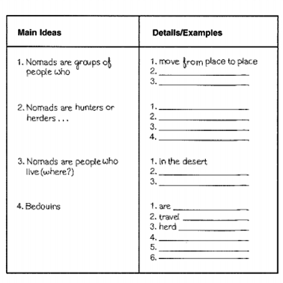
Note-taking
Coding System for note taking
A (Agree) | ! (Surprising)
? (Confused/question) | √ (Confirms what I thought)
D (Disagree) | X (Contradicts what I thought)
E4 (Evidence for) | CE (Cause/effect)
MP (Main idea/Purpose | B (Bias)
VIP (Very important) | WA (Weak argument)

Slide 8
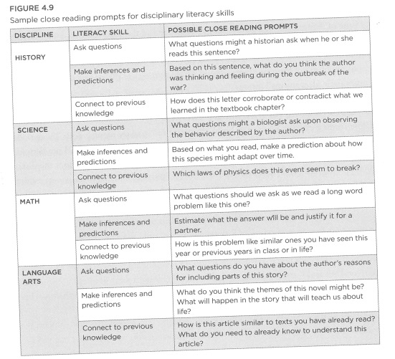
Close Reading

Slide 9
Complex Sentences: Independent Access for ELs
Sentence Dissecting Strategy
1. Give each group a copy in large print of the same syntactically complex sentence which contains key information on the topic being studied.
2. Specify the amount of time for groups to “dissect” the sentence. This means they write down as many simple sentences as possible based solely on the information in the given sentence.
3. At the end of the allotted time, groups post their charts of the dissected sentence around the room.
4. The group with the most valid dissected sentences wins.
by Elizabeth Hartung-Cole (2015)

Slide 10
Example: Sentence Dissecting Strategy
In an event leading to the outbreak of World War I, Archduke Franz Ferdinand, nephew of Emperor Franz Josef and heir to the throne of Austria-Hungary, was assassinated with his wife by a Serbian nationalist in Sarajevo, the capital of Bosnia, in 1914.
One Group’s Valid Responses
1. Archduke Franz Ferdinand was the heir to the throne of Austria-Hungary.
2. Archduke Franz Ferdinand was assassinated.
3. Archduke Franz Ferdinand’s wife was assassinated.
4. They were killed by a Serbian nationalist.
5. They were killed in Sarajevo.
6. Sarajevo is the capital of Bosnia.
7. They were killed in 1914.
8. This assassination led to the outbreak of World War I.
9. Archduke Ferdinand’s first name was Franz.
10. Emperor Josef’s first name was Franz.
11. Austria-Hungary had a throne.
12. Franz Ferdinand was an archduke.
13. Franz Josef was an emperor.
14. Emperor Franz Josef was Archduke Franz Ferdinand’s uncle.

Slide 11
Creating Complex Texts
Requirements of Academic Writing:
Students must learn new ways to organize and present language in the discipline
They must use academic register
Writing requires students to expand vocabulary, vary sentence structures, and learn how to use dependent clauses
Academic writing requires the thinking skills of analysis, causal reasoning, evaluation, and argumentation
Our oral language influences how we write
Another powerful influence on writing is reading – teaching students how to closely read and analyze texts can help them become more successful writers.

Slide 12
Writing
 | MOST SUPPORT
Teacher writing | The teacher demonstrates the writing of a text, discussing his/her thinking as he/she writes
Shared writing | The teacher records a text that the students dictate; supports student generation of ideas by asking questions and reflecting on text content, development, organization, conventions, etc.
Choral writing | Teacher and students write a text together; teacher and individual students take turns generating and recording new ideas
Guided writing | Individual students write a text, with the teacher providing support as necessary
Paired writing | Two students write a text together
Independent writing | Each student writes a text independently
 | LEAST SUPPORT

Slide 13
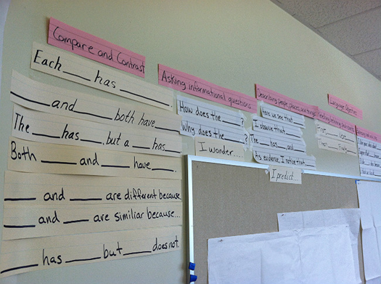
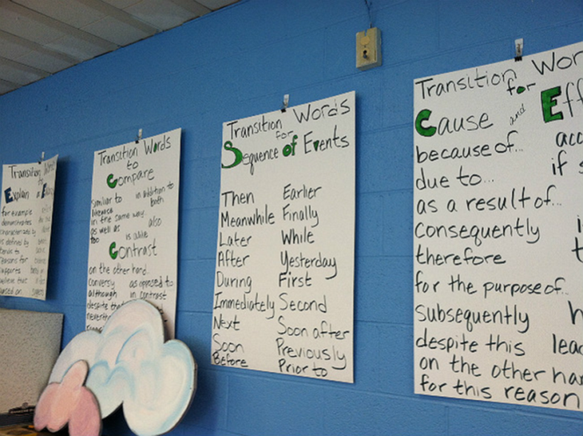
Support for Independent Writing
Word walls
Thematic word charts
Sentence frames and stems
Personal word books
Dictionaries
“Mini-Lessons”

Slide 14
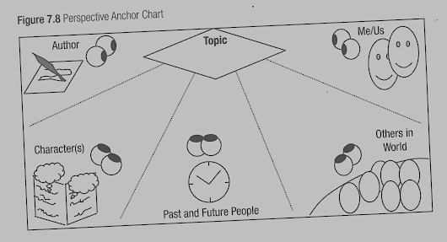
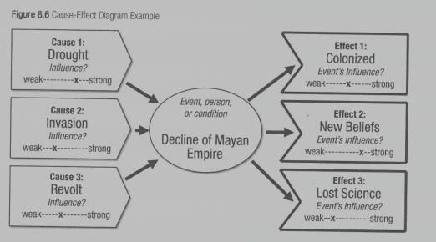
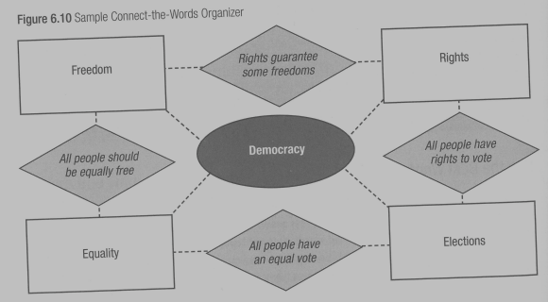
Scaffolding Academic Writing: Graphic Organizers

Slide 15
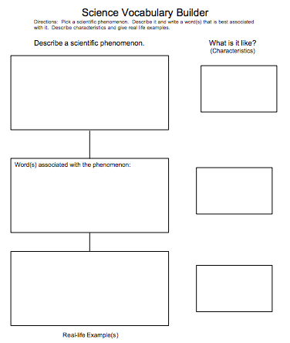
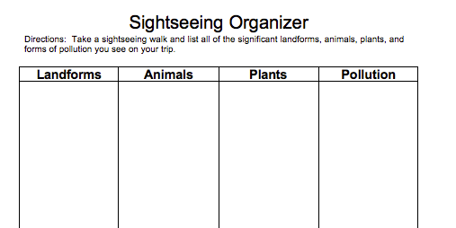
Scaffolding Academic Writing: Graphic Organizers

Slide 16
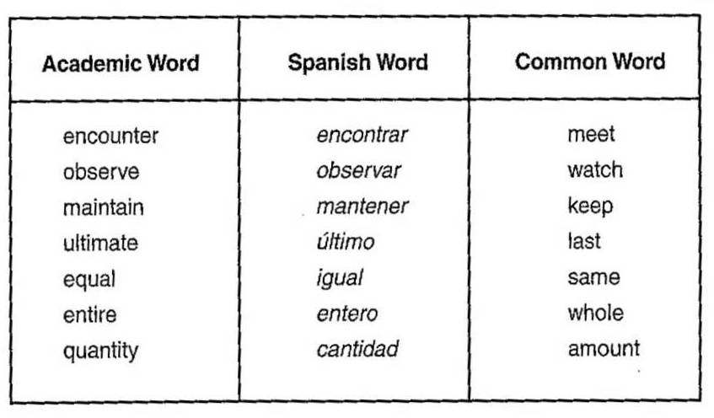
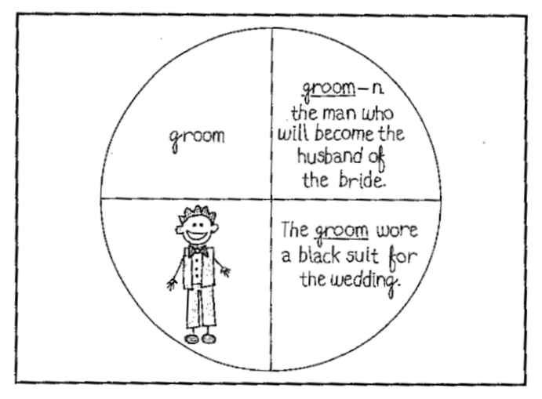
Vocabulary Notebooks

Slide 17
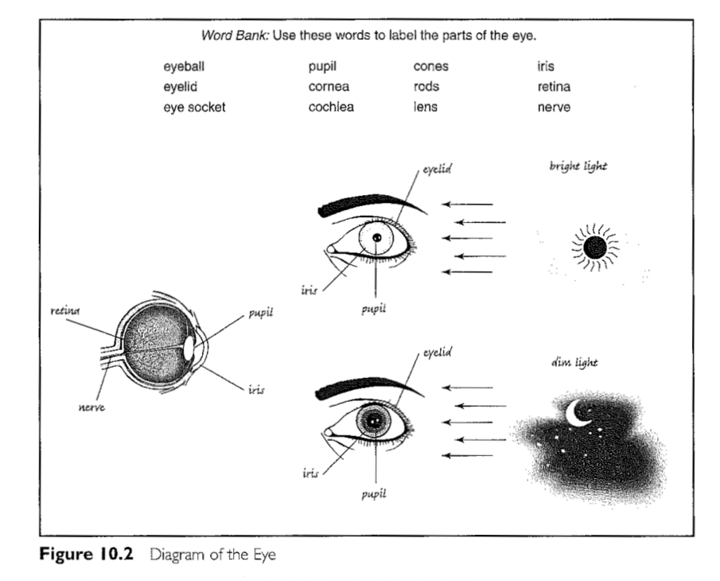
Word Banks

Slide 18
Vocabulary Activities
small
tiny
miniscule
microscopic

Slide 19
Beginning Learners: Code Switching in Writing

Slide 20
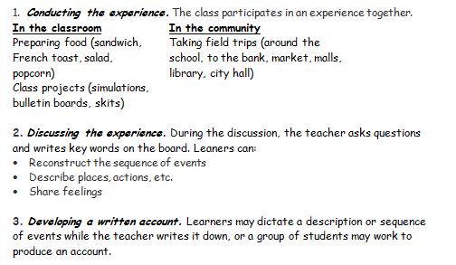
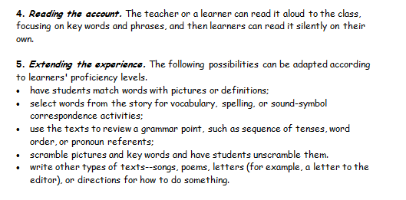
Language Experience Approach Taylor, 1992

Slide 21
Informal Writing Activities
Learning Logs and Journals
I learned that…
I realized that...
We read about... in order to...
An important concept is... because…
Perspective Papers
“I am a white blood cell. I like to travel and take care of problems, such as bacteria that invade the body...”

Slide 22
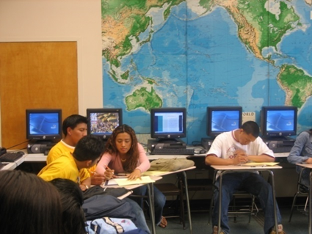
Digital Media and the Internet
Technology makes real world contexts accessible to learners
It enables students to explore their identities through relationships with their community, culture, and world (Warshauer, 2003)

Slide 23
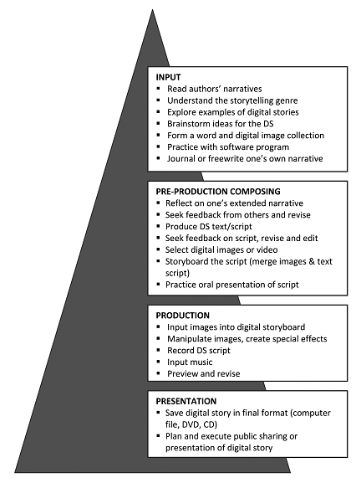
Digital Storytelling
Digital Story
the telling of a significant story (your own or another’s)
through the digitized visual presentation of a series of
image captures (still photos, drawings, video clips, icons)
the inclusion of text (titles, captions, word art)
the relating of that story in the voice of the creator
often accompanied by music
Rance-Roney & Young (2010)
Foltz, 2013

Slide 24
Work in Grade-level Teams
Continue working on planning your unit
Identify appropriate language objectives (forms/functions) for individual lessons
Design tasks for academic listening, speaking, reading, and writing
Make sure you include at least one oral practice routine in each lesson!

Slide 25
Lesson-sharing on May 10
You can present in groups or individually. Each presentation should last about 20 minutes.
Share the goals/objectives for your unit, and provide an overview of how you incorporated the ELP standards and some of the strategies/tasks/routines we have discussed
Choose one procedure/stage of one lesson to focus on. You can either demonstrate (“teach”) it to the group, or you can explain what you did.
Reflect on how things went, what you learned, successes, what you will do differently next time. How did your ELs perform in the unit?
If possible, share pictures of students performing your activities, sample materials, samples of student work, etc.

