Slide 1



Sheltered Instruction for Secondary Teachers
Centennial School District
Maria Dantas-Whitney, Ph.D. – Western Oregon University - dantasm@wou.edu

Slide 2
Overview of Professional Development:
Language Arts & Social Studies
Day 1: February 29 (8am-3pm) | Second Language Acquisition & School Expectations Components of Sheltered Instruction Academic Language Introduction to the ELP Standards Dimensions of Academic Language Grade-level teams: Examining the language demands of lessons Pairing content standards with ELP standards
Day 2: March 14 (8am-3pm) | Designing Language Objectives for Content Lessons Creating Classroom Tasks for Academic Listening and Speaking Creating Classroom Tasks for Academic Reading and Writing Grade-level teams: Identifying appropriate language objectives (forms/functions) for lessons Designing tasks for academic listening, speaking, reading, and writing
Day 3: May 10 (8am-11:20am) | Authentic Language/Content Assessment Classroom Assessment Tasks that Address Receptive (Listening and Reading) and Productive (Speaking and Writing) Modalities Differentiating Language Assessment Tasks According to ELLs’ Proficiency Levels Teacher Presentations

Slide 3
Resources
Project website:
http://dantas-whitney.weebly.com/

Slide 4
Plans for Today
Introductions
Second Language Acquisition and School Expectations
Academic Language
Principles of Sheltered Instruction
Introduction to the ELP Standards
Dimensions of Academic Language
Grade-level teams:
  Examining the language demands of a unit of instruction
  Pairing content standards with ELP standards

Slide 5

Introductions: Clock Appointments
Find a partner for each of the times below and write your partner’s name in the blank for that time.
When asked to get in groups for a specific time, the person written in that time’s blank will be your partner.
You will rotate and talk to each partner for about three minutes about the topics assigned.

Slide 6
12 o’clock partners
Three minutes:
  Introduce yourself
  Share with your partner:
    Profiles of the English Learners in my classes
      linguistic/cultural/social backgrounds
      academic needs

Slide 7
3 o’clock partners
Three minutes:
  Introduce yourself
  Share with your partner:
    Successes I have had in supporting my EL students

Slide 8
6 o’clock partners
Three minutes:
  Introduce yourself
  Share with your partner:
    Challenges I have had in supporting my EL students

Slide 9
9 o’clock partners
Three minutes:
  Introduce yourself
  Share with your partner:
    Questions I have about best practices for EL students

Slide 10
Debriefing
Profiles of the English Learners in my classes
Successes I have had in supporting these students
Challenges I have had in supporting these students
Questions I have about best practices

Slide 11

Factors Influencing the Length of Time Needed to Acquire English
Quality and length of previous education
Prior English learning experiences
Literacy levels in the family
Mobility
Family separation
Cultural isolation
Exposure to social unrest, war, or trauma

Slide 12
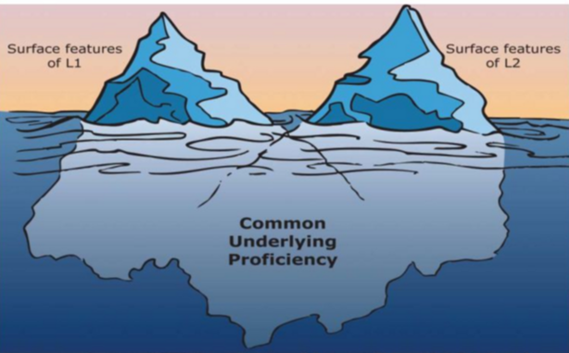
Common Underlying Proficiency
Cummins (2000)
Common Underlying Proficiency refers to the interdependence of concepts, skills and linguistic knowledge found in a central processing system
Cognitive and literacy skills established in the primary language will transfer across languages

Slide 13
The Role of Home and Community
Our social experiences, cultural practices, ways of thinking, communication styles are powerful (but often invisible) foundations for learning
Certain home-based language practices of mainstream, middle class families (e.g., storybook reading, questioning at dinner) correlate strongly with academic success
  Williams (1999) -- higher social group of mothers frequently asked children to elaborate on parts of a book, connect to experiences, provide explanations, add opinions, etc.
  Philips (1983) -- research in Warm Springs: children were perceived to be overly silent and uncooperative. Teachers created learning situations that resembled oral participation contexts in the community, and involvement increased
Zwiers, 2014

Slide 14
Types of Capital and School Expectations
Types of Capital: less visible words, skills, and knowledge that give people advantage (Bourdieu, 1986)
  Social Capital
    amounts and qualities of interactions – listening abilities, listening skills, appropriate behaviors, responses
  Cultural Capital
    travel experiences, wealth, parent education, music listened to, being read to, religion-related experiences
  Knowledge Capital
    Knowledge accumulated from reading, conversations about the world, educational/computer/news programs, developing organizational abilities with knowledge, word memory abilities
  Linguistic Capital
    Quantity and quality of language used at home and in peer group, literacy/computer experiences at home, developing abilities to use abstract language
Invisible Criteria in School:
  School expects background knowledge and language features that are not explicitly taught
  Diverse students end up doing guesswork: “Read critically,” “Speak clearly,” “Stick to the point,” “Use your won words”

Slide 15
The Language of School
Many ELs who perform poorly…
  were not immersed from birth in the types of language that are valued by schools, teachers, texts, and tests
  have not been exposed to the same conversations/literacy experiences that constitute an “apprenticeship” for success at school
  Are not able to naturally pick up academic language as they pick up other types of social language
As students get to middle and high school, the gap widens between students’ communication skills and the language demands of academic tasks (especially in CCSS, NGSS)
We must continually reflect on the power that language has to separate, marginalize, and oppress
“Pedagogy of entrapment” (Macedo, 1994): when schools require from students academic discourse skills and knowledge that we don’t teach
Zwiers, 2014

Slide 16
BICS vs. CALP
Basic Interpersonal Communication Skills
Cognitive Academic Language Proficiency
Cognitively | Undemanding
A Buying snacks Oral Instructions Some classes (art, P.E.) BICS | C Talking on the phone Basic written instructions BICS
Context Embedded--- | ---Context Reduced
B Lab demonstrations A-V assisted lessons Projects CALP | D Standardized tests Teacher lectures Most content classes CALP
Cognitively | Demanding

Slide 17
Academic Language
Build on the ideas of others and express own ideas clearly in collaborative discussions
Abilities to construct meaning from oral and written language, relate complex ideas and information, recognize features of different genres, and use various linguistic strategies to communicate
Roles of Academic Language
Support ideas with evidence from text
Determine how themes and main ideas are conveyed through particular details in the text
Construct viable arguments, and critique the reasoning of others
Identify and describe patterns or sequences
To describe complexity | explaining the plot of a story, the concept of the black hole, the causes of the French Revolution, the Fibonacci sequence
To describe higher order thinking | constructing an argument in Language Arts, examining historical trends in social studies, application and problem-solving in math, analyzing data in science
To describe abstraction | democracy, altruism, values and beliefs, relationships among objects or numbers, adaptation
Determine and describe cause-effect relationships
Determine and describe differences and similarities

Slide 18
ELs and Academic Language
“Mastery of academic language is arguably the single most important determinant of academic success for individual students” (Francis et al., 2007)
“For many ELs, school might be the only setting where they have the opportunity to encounter and acquire academic language, and their teachers might be the most significant source of oral academic language” (Ernst-Slavit & Mason, 2011)

Slide 19
Sheltered Instruction
Sheltered instruction involves designing lessons that integrate language development and comprehensible content instruction. Sheltered lessons have two goals:
  to provide access to mainstream, grade-level content. This is achieved through scaffolding strategies.
  to promote language development. This involves carefully analyzing the language demands of the lesson and designing language objectives that will help students increase academic language proficiency.

Slide 20
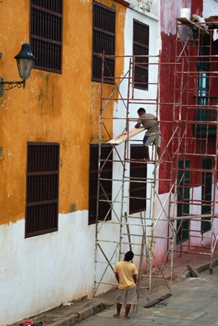
Scaffolding
Temporary help for learners to complete a task until they can perform independently
Take into consideration students’ …
  background experiences
  content knowledge
  language proficiency levels
Gradual release of responsibility
  Modeling, group practice, independent work
Hands-on activities and cooperative learning
  Teacher-centered presentations interspersed w/ small group tasks (e.g., think, pair, share)
  Preview/review
  Learning centers, labs, simulations
Written and oral instructions
Visuals, gestures and linguistic supports
  Graphic organizers, pictures, sketches, manipulatives, TPR
  Sentence frames, starters, transition words
  Primary language support and biliteracy development (e.g., use of cognates)
Guarded vocabulary
  Contextual definitions of words and concepts
  Repetition
  Shorter sentences and simpler syntax
  More pauses
  Vocab charts, words walls
Monitor, assess, and adjust

Slide 21
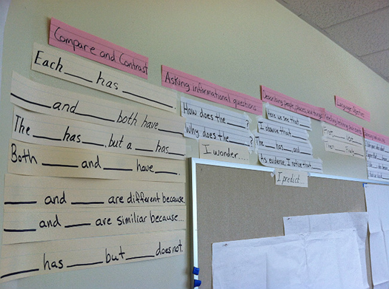
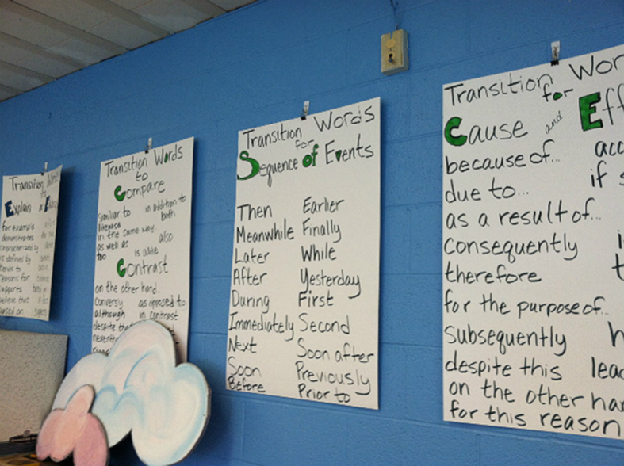
Targeted Language Instruction for ELs
Focus on helping English learners develop English language skills.
ELP standards are integrated into instruction. Lesson objectives are differentiated according to students’ language proficiency levels.
Academic vocabulary, sentence structures, genres/text types are taught and practiced.
Tasks incorporate the four language domains (listening, speaking, reading, writing)
Instruction is linked to the content areas as well as the linguistic needs of the students.

Slide 22
Four Zones of Teaching and Learning
(Gibbons, 2015)
High Challenge
Learning/ Engagement Zone | Frustration/ Anxiety Zone
Comfort Zone | Boredom Zone
“Construction zone”
“Zone of proximal development”
High Support
Low Support
Low Challenge

Slide 23


Slide 24
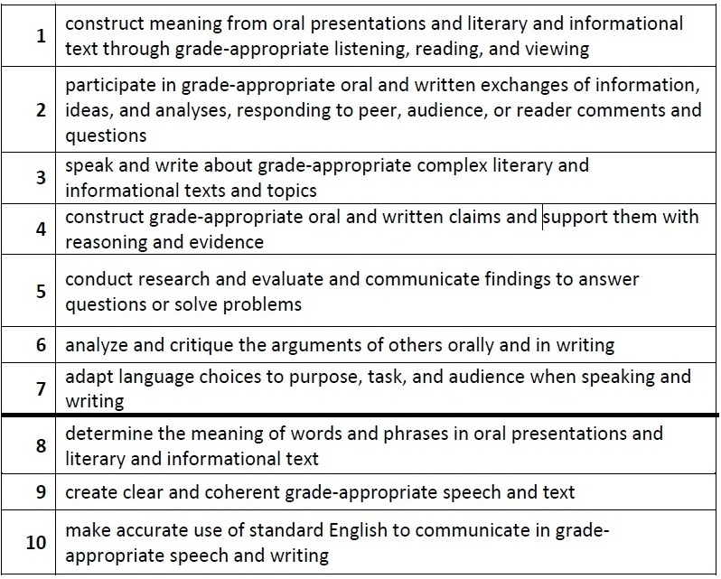
English Language Proficiency (ELP) Standards

Slide 25
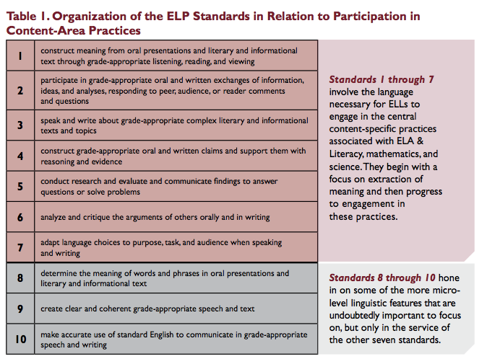

Slide 26
Language Modalities in the ELP Standards
(Listening, Speaking, Reading, Writing)

Slide 27
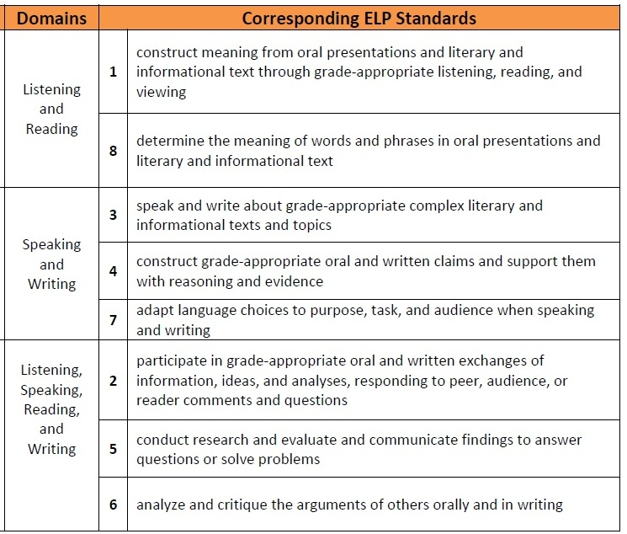
Modalities
Modalities
Receptive
Productive
Interactive
Notes:
Receptive modalities: This mode refers to the learner as a reader or listener/viewer working with ‘text’ whose author or deliverer is not present or accessible. It presumes that the interaction is with authentic written or oral documents where language input is meaningful and content laden. The learner brings background knowledge, experience, and appropriate interpretive strategies to the
task to promote understanding of language and content in order to develop a personal reaction.
Productive modalities: The mode places the learner as speaker and writer for a ‘distant’ audience, one with whom interaction is not possible or limited. The communication is set for a specified audience, has purpose, and generally abides by rules of genre or style. It is a planned or formalized speech act or written document, and the learner has an opportunity to draft, get feedback, and revise, before publication or broadcast.
Interactive modalities: Collaborative use of receptive and productive modalities. This mode refers to the learner as a speaker/listener [and] reader/writer. It requires two-way interactive communication where negotiation of meaning may be observed. The exchange will provide evidence of awareness of the socio-cultural aspects of communication as language proficiency develops.

Slide 28
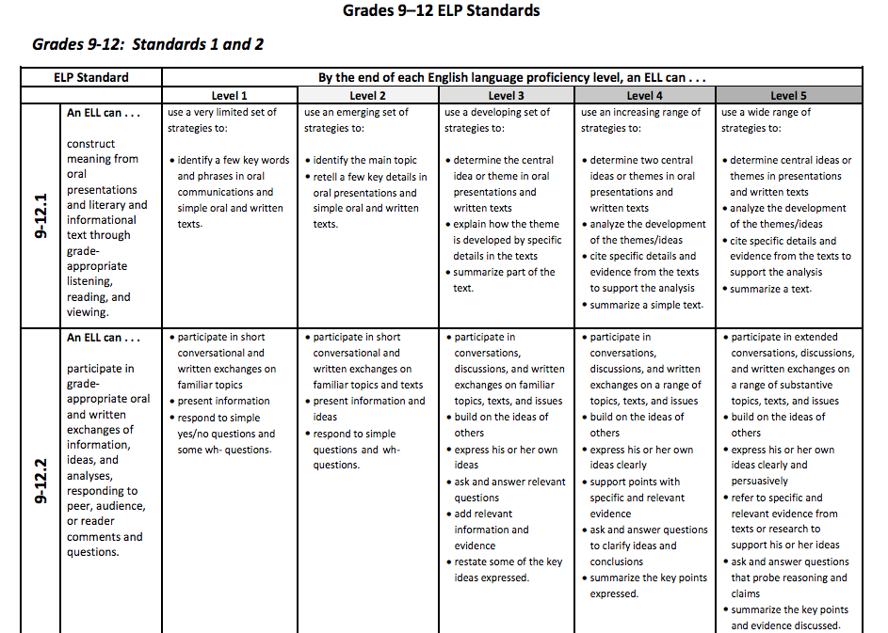
ELP Standards by Grade Level

Slide 29
Practices
Math
Science
Make sense of problems and solve them
Plan and carry out investigations
Use math and computational thinking
Reason abstractly and quantitatively
Analyze and interpret data
Construct arguments from evidence
Produce clear and coherent writing
Integrate, compare, and synthesize ideas from text
Build on the ideas of others and articulate one’s own ideas
ELA

Slide 30
Academic Language Functions

Slide 31
Standards
Math
CCSS for math
ELA
CCSS for ELA
Science
NGSS for science
English Language Proficiency Standards
corresponding to ELA, Math, and Science Practices
K-12 ELA Standards and 6-12 Literacy Standards

Slide 32
Unpacking the Standards
(six groups)
ELP Standard:
In our Words:
Language Modalities/Domains:
Language Functions:
Curriculum Ideas:

Slide 33


Slide 34
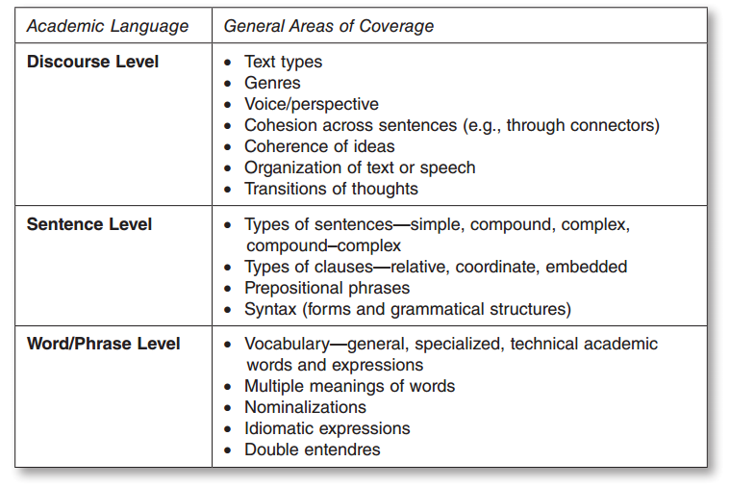
Dimensions of Academic Language
(Gotlieb & Slavit-Ernst, 2013)

Slide 35
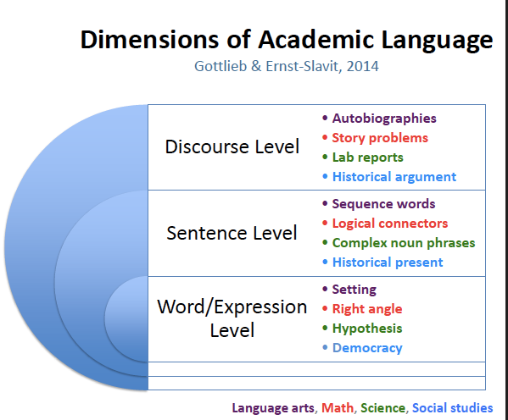

Slide 36
Vocabulary Type by Content Area
Academic Vocabulary | General | Specialized | Technical
English Language Arts | appropriate articulate assumption conclusion context demonstrate denote distribute generic inference itemize | semantic metaphor voice limerick (what else?) | soliloquy romanticism gothic burlesque (what else?)
Social Studies | opposition prompt restate reveal solution structure summary superfluous though trait | revolutionary constitutional policy supply (what else?) | chauvinism Magna Carta prime meridian signatory powers (what else?)

Slide 37
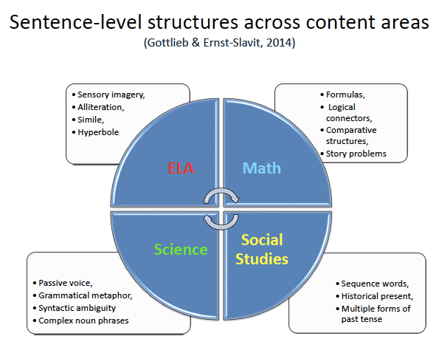

Slide 38
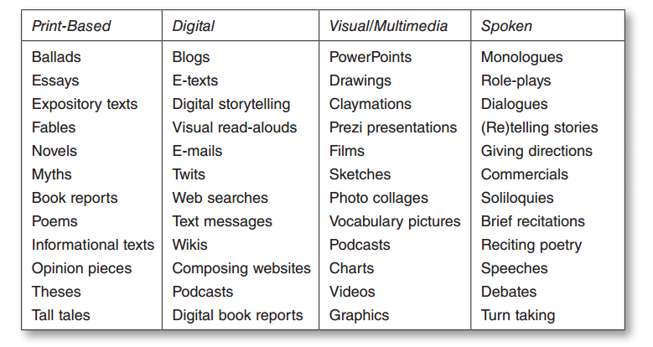
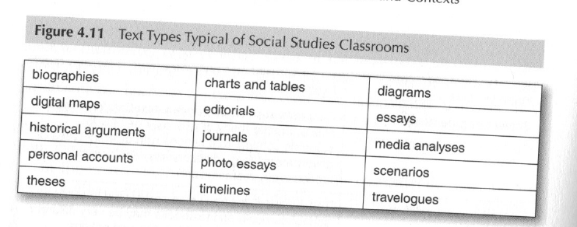
Discourse-level
demands in ELA
and
Social Studies

Slide 39

Academic Language Functions in ELA
(explicit in the CCSS)
ask and answer questions
recount information
tell stories
describe characters, settings, and major events, the structure of stories, relationships
compare and contrast themes, two versions of the same story, texts in the same and different genres, important points and details, structure of two texts
explain processes, how authors use reason and evidence
identify words and phrases in stories, main topics
explain differences between books
summarize points of a speaker
interpret information from different media
draw evidence from literary and informational texts
present claims and findings

Slide 40
Work in Grade-level Teams
Choose an instructional unit for analysis (a unit you will be teaching in March/April)
Analyze the academic language within the unit:
  Discourse level:
  Sentence level:
  Word/expression level:
  Language functions:
Pair the content standards you will target for this unit (CCSS or state standards for SS) with the appropriate ELP standards

